Slide 1
Central HPWH Work Group- AWHI
September 15, 2020

Slide 2







  HPWH are standard practice in new construction and retrofit
  COP ~ 3
  Low-GWP refrigerants
  Plug-and-play packaged systems
  Cost-effective
  Reliable
  Ability for load shift
VISION
Advance the development and adoption of HPWH Technologies faster together
Notes:
There is a way to align our efforts and arrive at this end state in 5 years
This what we are working for.

Slide 3

Updates
Manufacturer Updates
Distributor
Code
Demonstration, pilots or other studies

Slide 4
Market Potential Forecast
Mark Frankel Ecotope

Slide 5
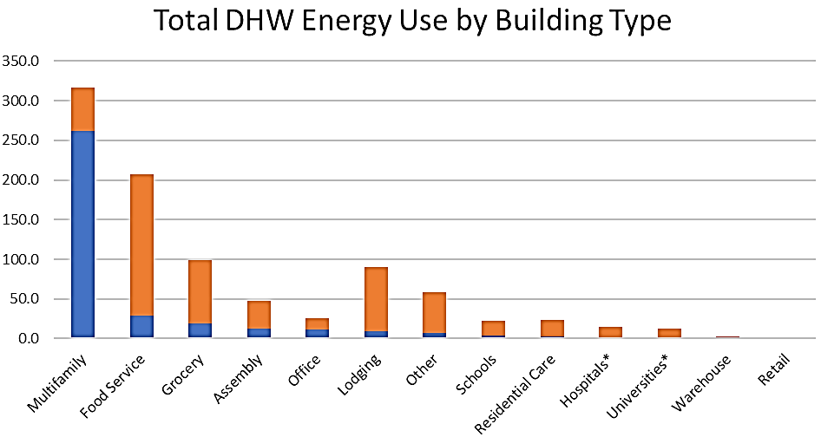
Current PNW DHW Energy Use
by fuel and building type
What subset of this CHPWH capacity will be over a 10-year timeframe? And at what rate?

Slide 6
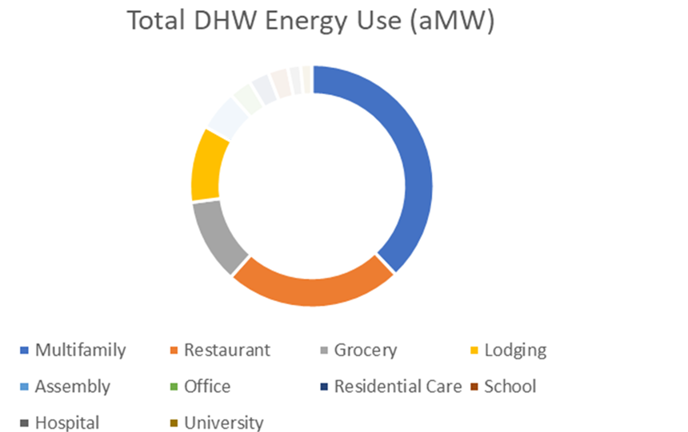
Four Building Types
Multifamily
Food Service
Grocery
Lodging
83 %

Slide 7
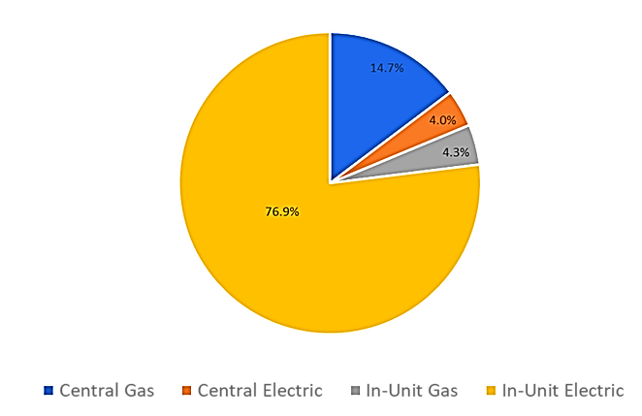
Multifamily System Distribution
How many existing central systems will convert to CHPWH?
What percentage of new construction will deploy CHPWH?
How much new MF will be built?
What will the impact of decarbonization policies?

Slide 8
Information Needs
Information Input | Potential Source
DHW End Use by Building Type | CBSA, CEUS, CBECS, DOE
System Distribution | CBSA, Other
New Construction Build Rate | Census Data, Dodge Index, Muni forecast
Regional Building Population Weighting | DOE, CBECS
System COP | Testing, Manufacturer Literature
Runtime/Capacity Factor | Engineering Estimates
Adoption Potential | Market Survey

Slide 9

“Survey Says…”
Participant Role
Regional Policy Perspective
Regional Policy Goals (10 year)
Estimate of Adoption Rates (1, 2, 3, 5, 10 years)
Number of Units Deployed
Equipment Availability
Refrigerant Transition
Decarbonization

Slide 10
Technology Innovation Model (TIM)

Slide 11
Parallel Development Paths
Policy Development
Code Development Research
Prescriptive Path
Modeling Path
Title 24
Code Adoption
Technology Innovation Model
Manufacturer Packaged Systems
Feasibility Study
Application Testing
Demonstration
M&V
System Metrics
Market Deployment Support
Manufacturer Support Docs
Outreach
Case Studies
Pilot Projects
Best Practice Guides
Training Modules
Utility Program Development
Programs Deployed
Program Goals
Program Design
Pilot Programs

Slide 12
Technology Innovation Model (TIM)
Feasibility Study
Application Testing
Demonstration
M&V
System
Metrics
Manufacturer
Engagement
Outreach
Development Assistance
Market Criteria
Component Descriptions
Supporting Research
Performance Testing
System Specifications
Performance Parameters
Testing
Performance
Map
Tool Development
Sizing Tool
Temperature Maintenance Module
Load Shift Module
Performance Simulation Model
Temperature Maintenance
Research / Data Analysis
Temperature Maintenance Best Practice
Application
Guidelines
Notes:
Developed TIM to speed product development in US marketplace – fail fast, bring engineering applications focused feedback to manufacturers – market intelligence.
Partner with manufacturers to shift orientation from selling heat pumps for custom engineering solutions to selling plug-and-play complete hot water system solutions
Shift to plug-and-play introduces standardization which removes risk from contractors, reduces need for detailed training (follow the instructions), eliminates failures in the field which give the technology a bad name and slow adoption, reduces cost

Slide 13
Plug-and-play Systems
A system of components appropriately sized for DHW needs
  Design firms, manufacturers, or suppliers use sizing tools
Compressor, Storage Tanks, Temperature Maintenance, Mixing Valve
Purchased pre-packaged on a skid or individual components with assembly instructions
  Easy install, single point of contact, reliable performance
Mitigates perceived risk from contractors using multiple subs
  Correct components
  Reduced risk
  Reliable results
  Reduced pricing over time
Notes:
Used TIM and successfully transformed a residential product into a multifamily product
Steffas and California Hydronics, Columbia, Casdia Hydronics sample skid manufacturers.
It appears to be higher first cost of packaged system, but may not be the case once you account for the various trade labor to install the different components. Pre-packaged systems are plug in and go. \
Goal: Nordstrom style and service at Costco wholesale prices.
. Everything from one place if something goes wrong. N
WANT IT PRE-PACKAGED OR THE PARTS AND PIECES TO SHOW HOW IT IS PUT TOGETHERot general and multiple subs.

Slide 14
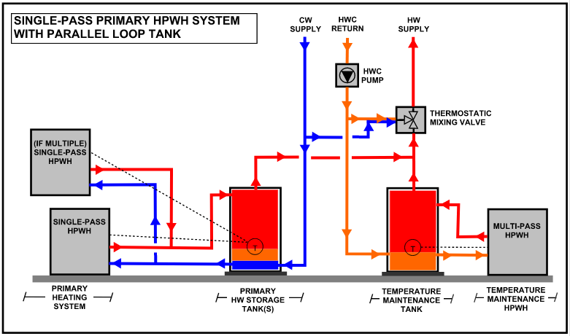
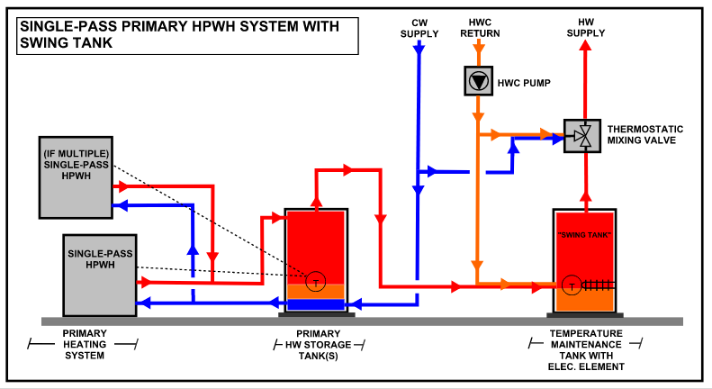
A Winning System: Plug-N-Play
4 System Components: Design Support along with
Heat Pump, Storage Tank, Mixing Valve and Temperature Maintenance
Notes:
Plus the Design – DO NOT OVERSIZE
including heat pumps, tanks, mixing valve, temperature maintenance system
Two ways of dealing with Temp Maint. A parallel loop tank and swing tank.
Can be skid mounted or all the parts and pieces & design support

Slide 15
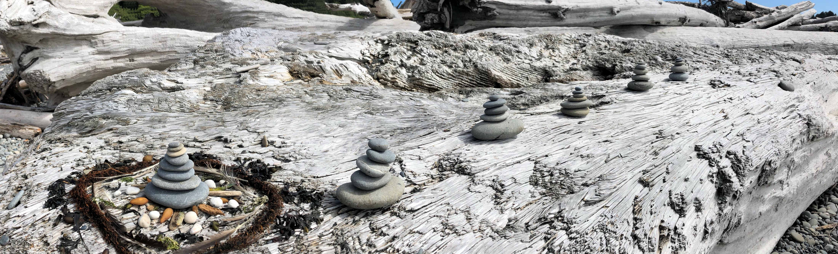

Shawn Oram, PE
Director of Design and Engineering
Ecotope, Inc.
shawn@ecotope.com
Sanden Multifamily

Slide 16
Why Central Heat Pump Water Heating?
Significant Peak Load Reduction
Reduces DHW Energy Usage By 65%
Demand Response Capable
Thermal Battery

Slide 17

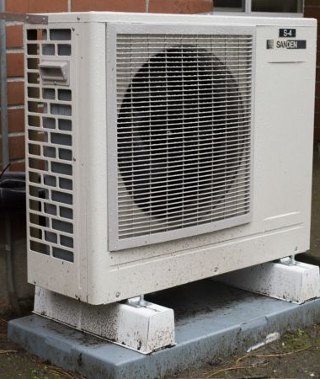
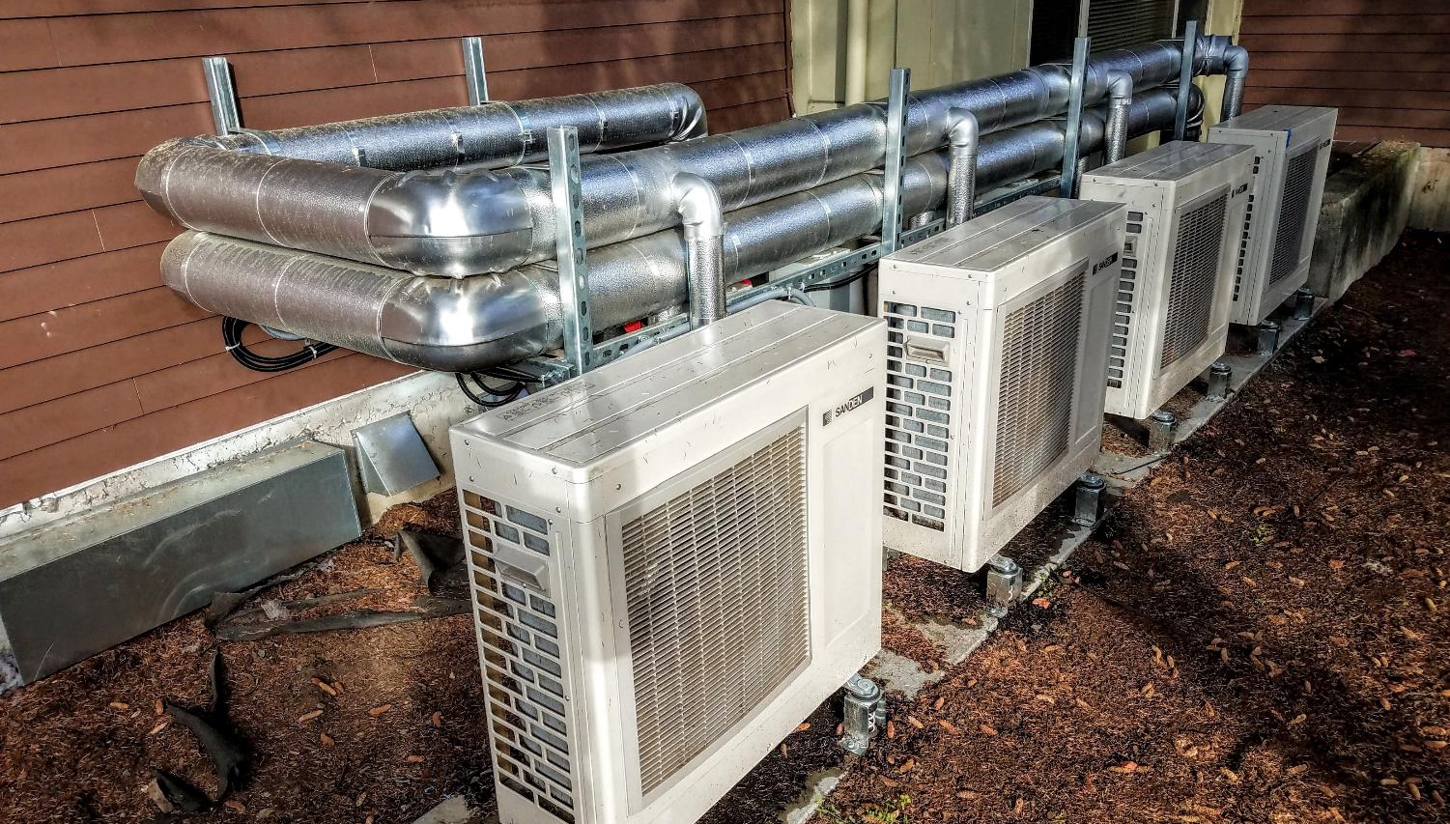
Cold Climate Central Heat Pump Water Heaters.
There are no large central heat pump water heating equipment options to serve the Northern US multifamily markets.
Requirements:
Operate down to -10 F EAT.
Make 170 F DHW
Low GWP refrigerant
Single pass operation
Load shift capable
Control system with alarms

Slide 18
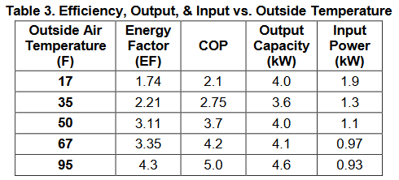
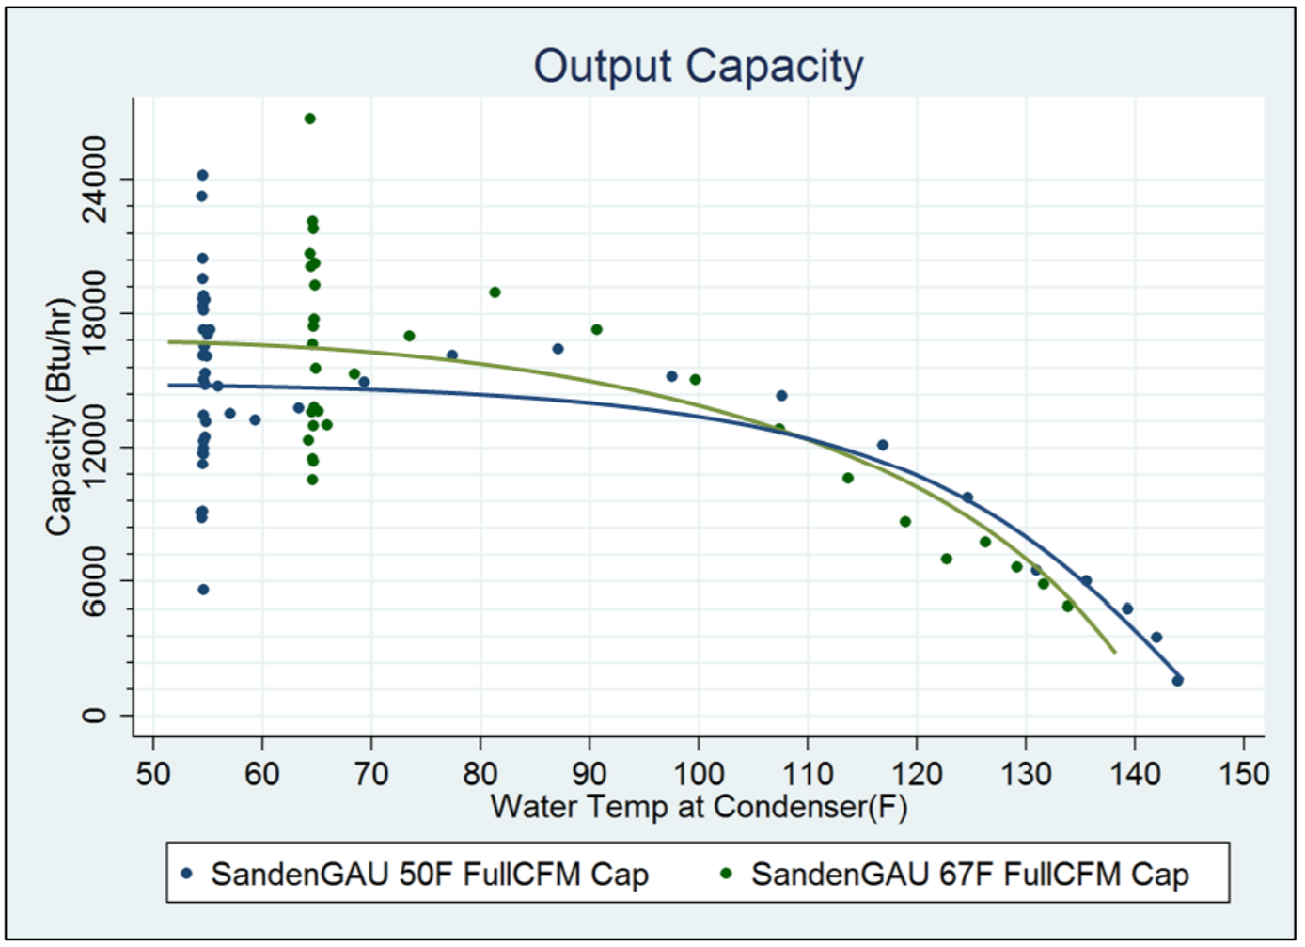
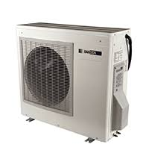
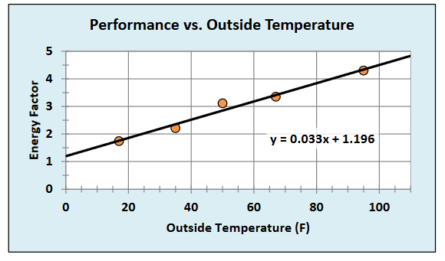
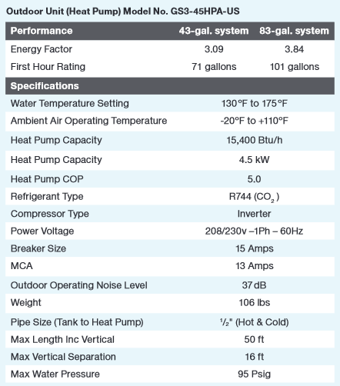
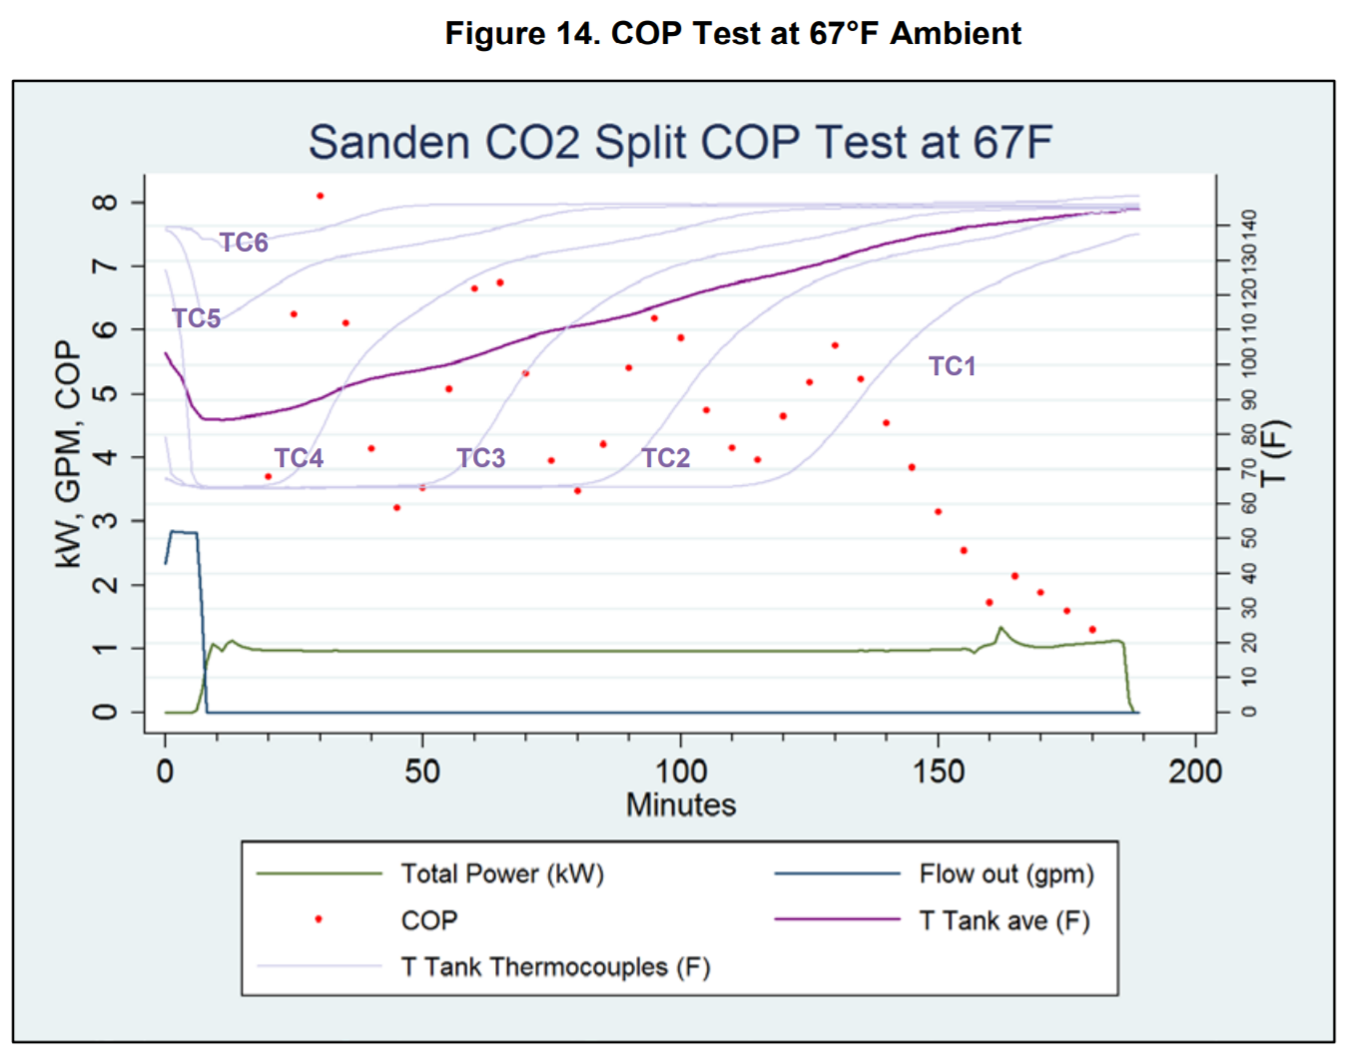
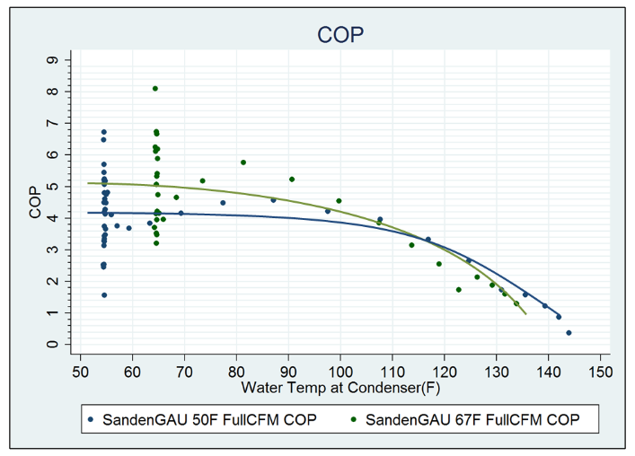
Sanden CO2 HPWH

Slide 19
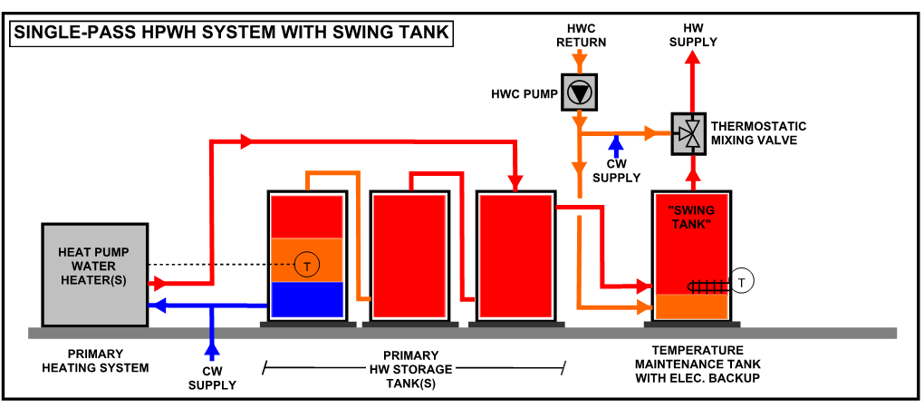
Single Pass Design

Slide 20


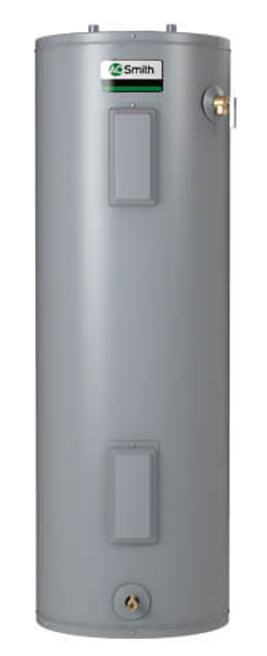

Sanden Multifamily Packages
Occupants Served | Number of Sanden’s | Hot Water Storage (Gal) | Hot Water Storage w/Load Shift (Evening/Evening+Morning) | Swing Tank Gal (kW) | Controls (Basic or Advanced)
40 | 4 | 263 | 479/680 | 80 (5kW) | B or A
70 | 6 | 461 | 838/1190 | 150 (9kW) | B or A
100 | 8 | 661 | 1197/1700 | 200 (13kW) | B or A
125 | 10 | 830 | 1497/2125 | 250 (18kW) | B or A

Slide 21
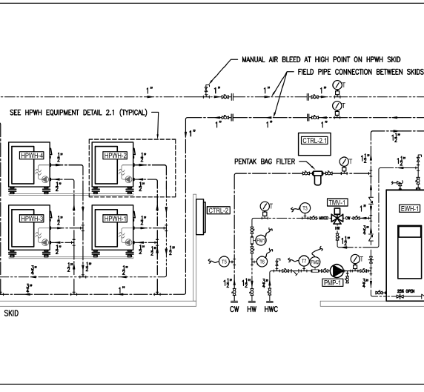
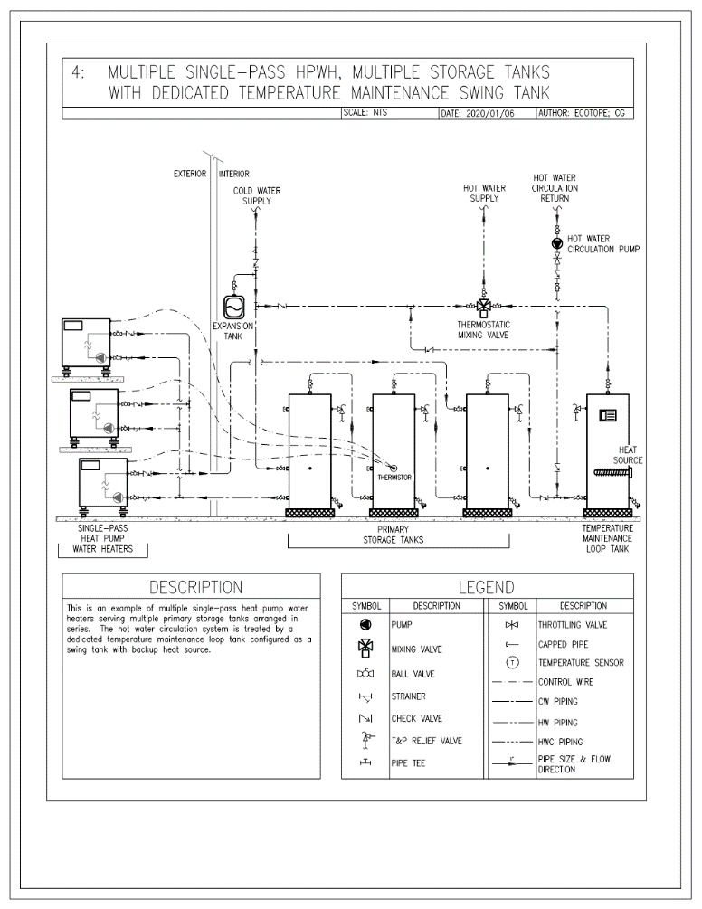
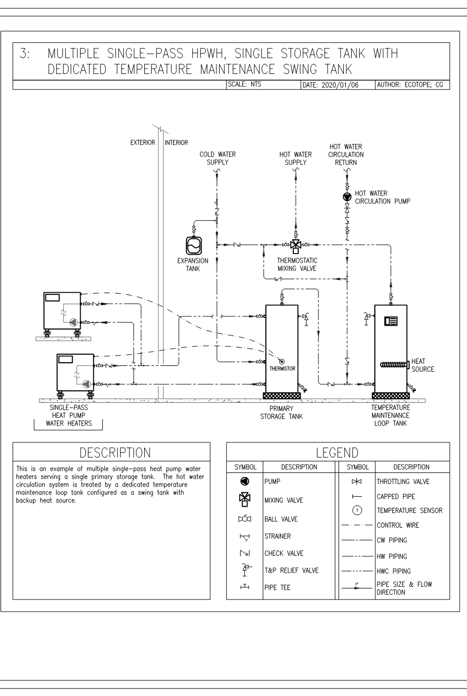
Installation Instructions

Slide 22
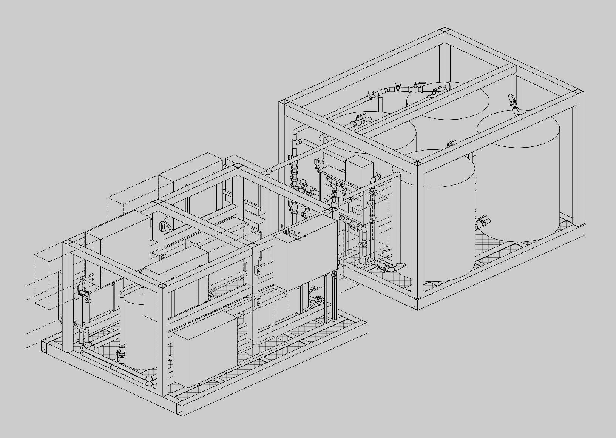
Plug and Play Sanden Multifamily Rooftop Skid
Meets Northern Climate Specs for CHPWH as well as California’s ACM for Multifamily CHPWH
System configuration of skid of storage tanks and a skid of heat pumps w controls
Deliver, hoist to roof-curb, plug in water, electrical, connect data and ready for startup procedures
Controls options - basic and advanced control package
Load-shift enabled

Slide 23
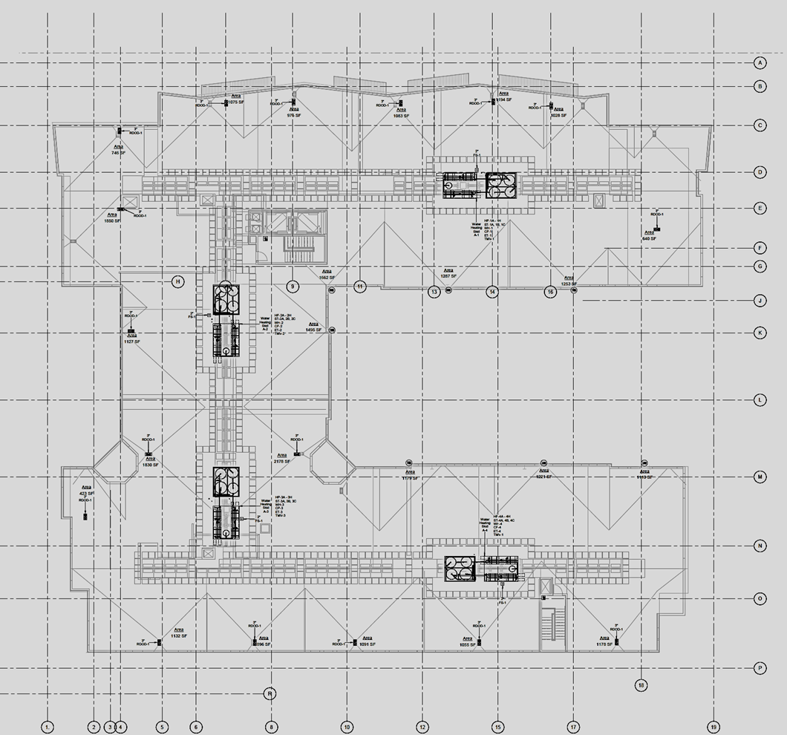
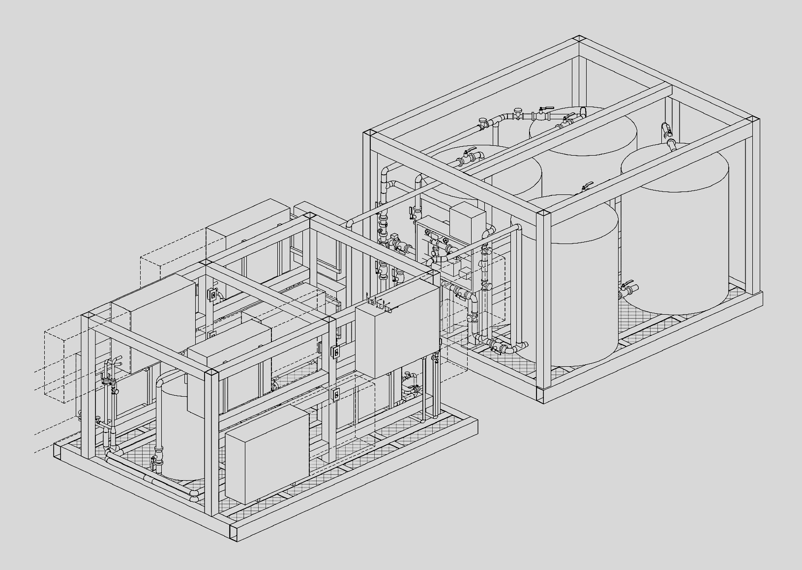
Menlo Park Roof Top Skid Installation
400 People, 250 Units
4 Rooftop (100 Person) DHW Plants
4 Small Hot Water Distribution Loops
Installed in Q1 2022

Slide 24
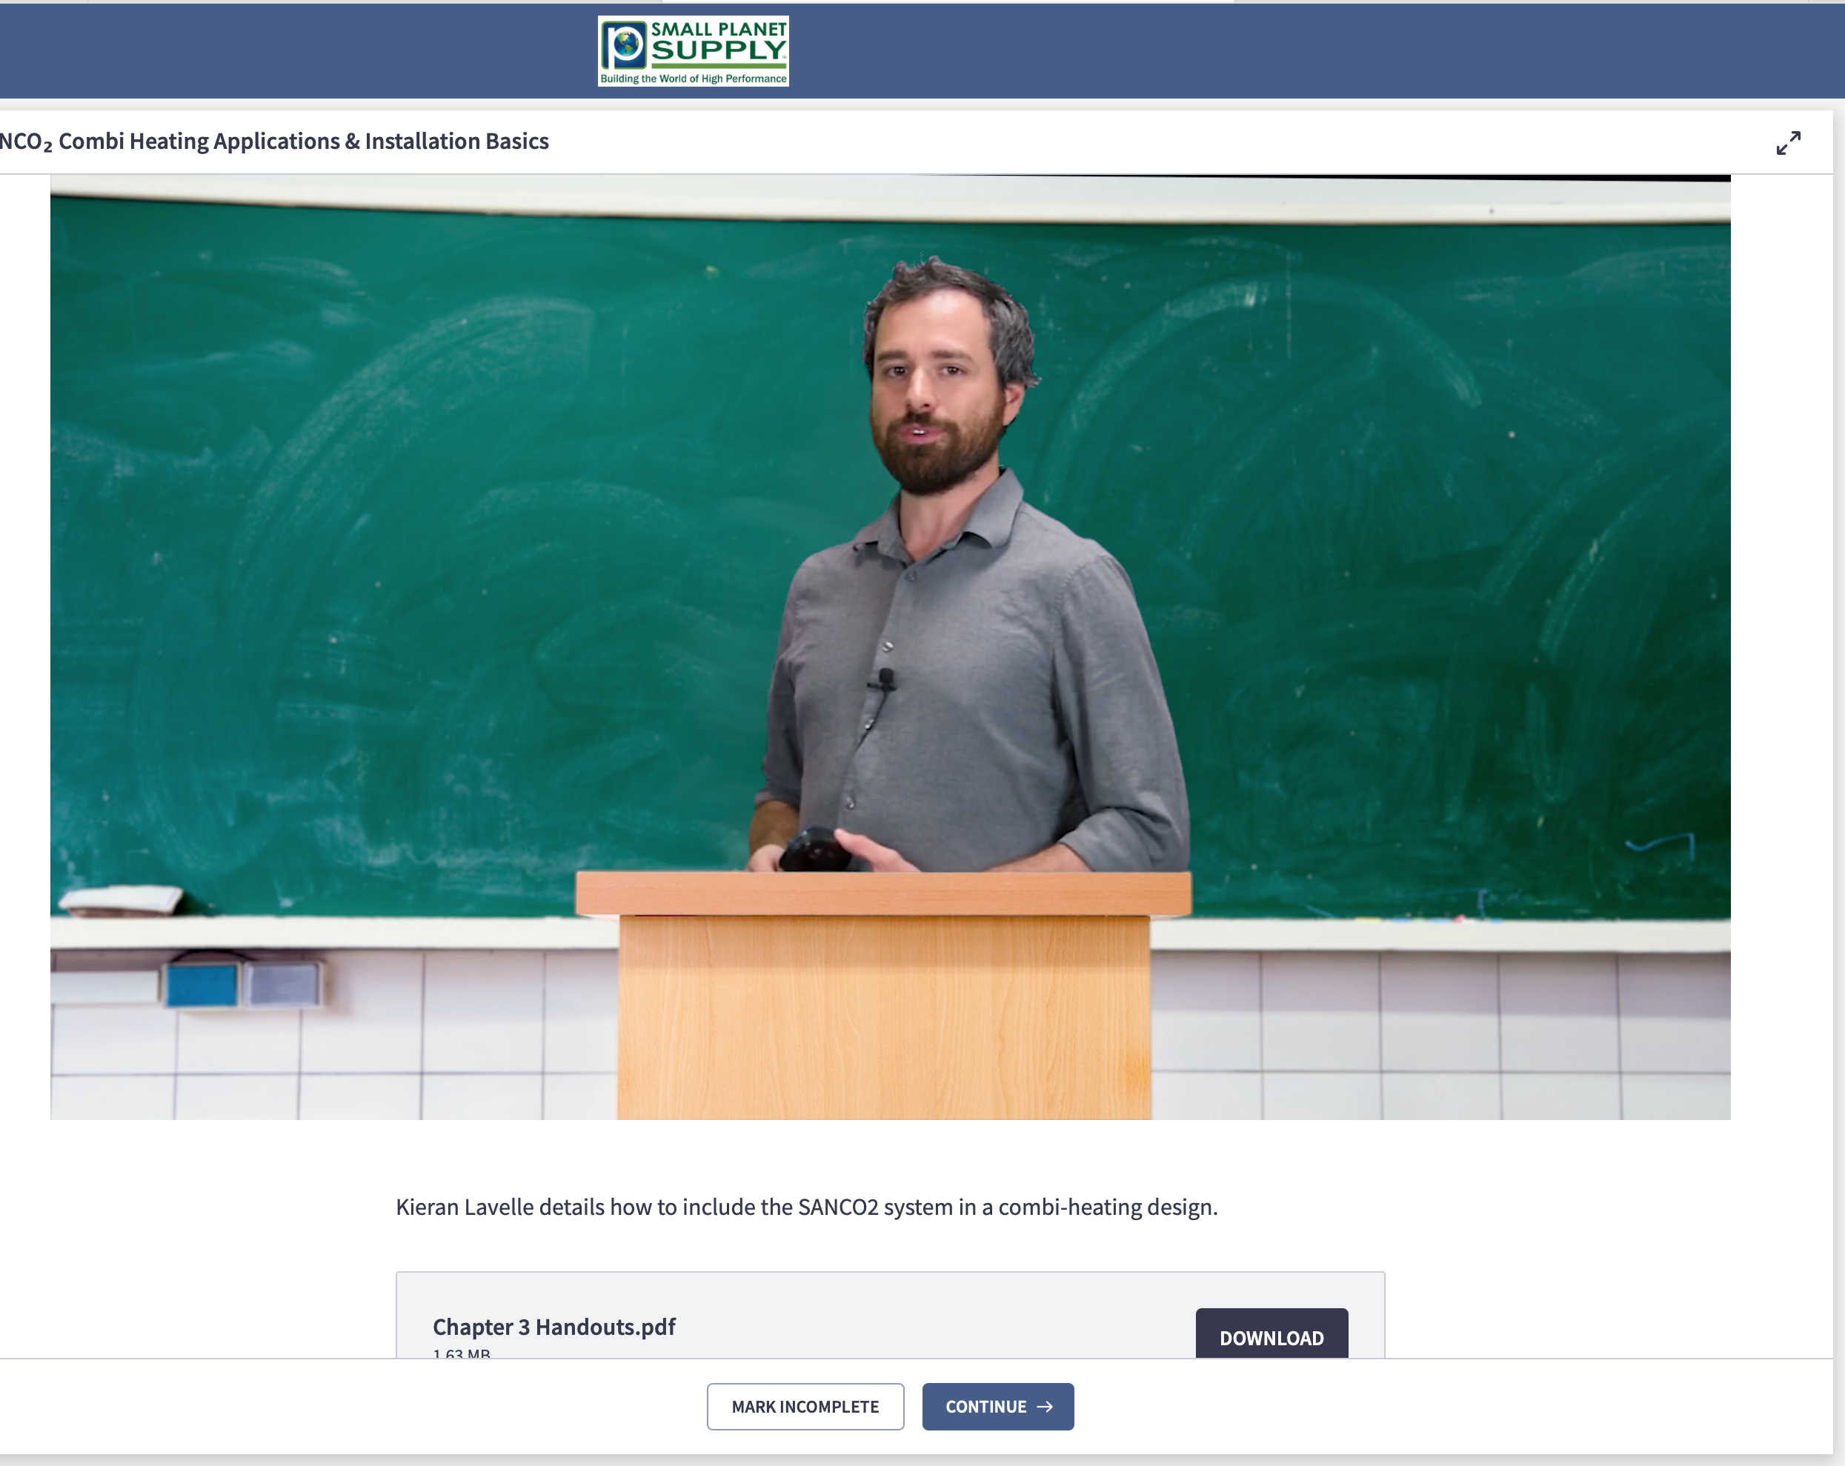
On-line Pre-Bid Certification Course
Held online at Small Planet’s Learning Center
Course created to provide basic understanding of system to prevent “risk pricing”
Bidders required to prove course completion as bid pre-requisite
https://www.smallplanetsupply.com/learning-center
Notes:
Small Planet Supply, Olympia, Washington
High performance buildings, Passivhaus & Zero Energy Buildings
Pre-qualification of installers training approach for multifamily systems
Training program (website videos)
Single distribution channel for plug-n-play package
Provides technical and design support
How many, how much, how did you figure parts and pieces

Slide 25
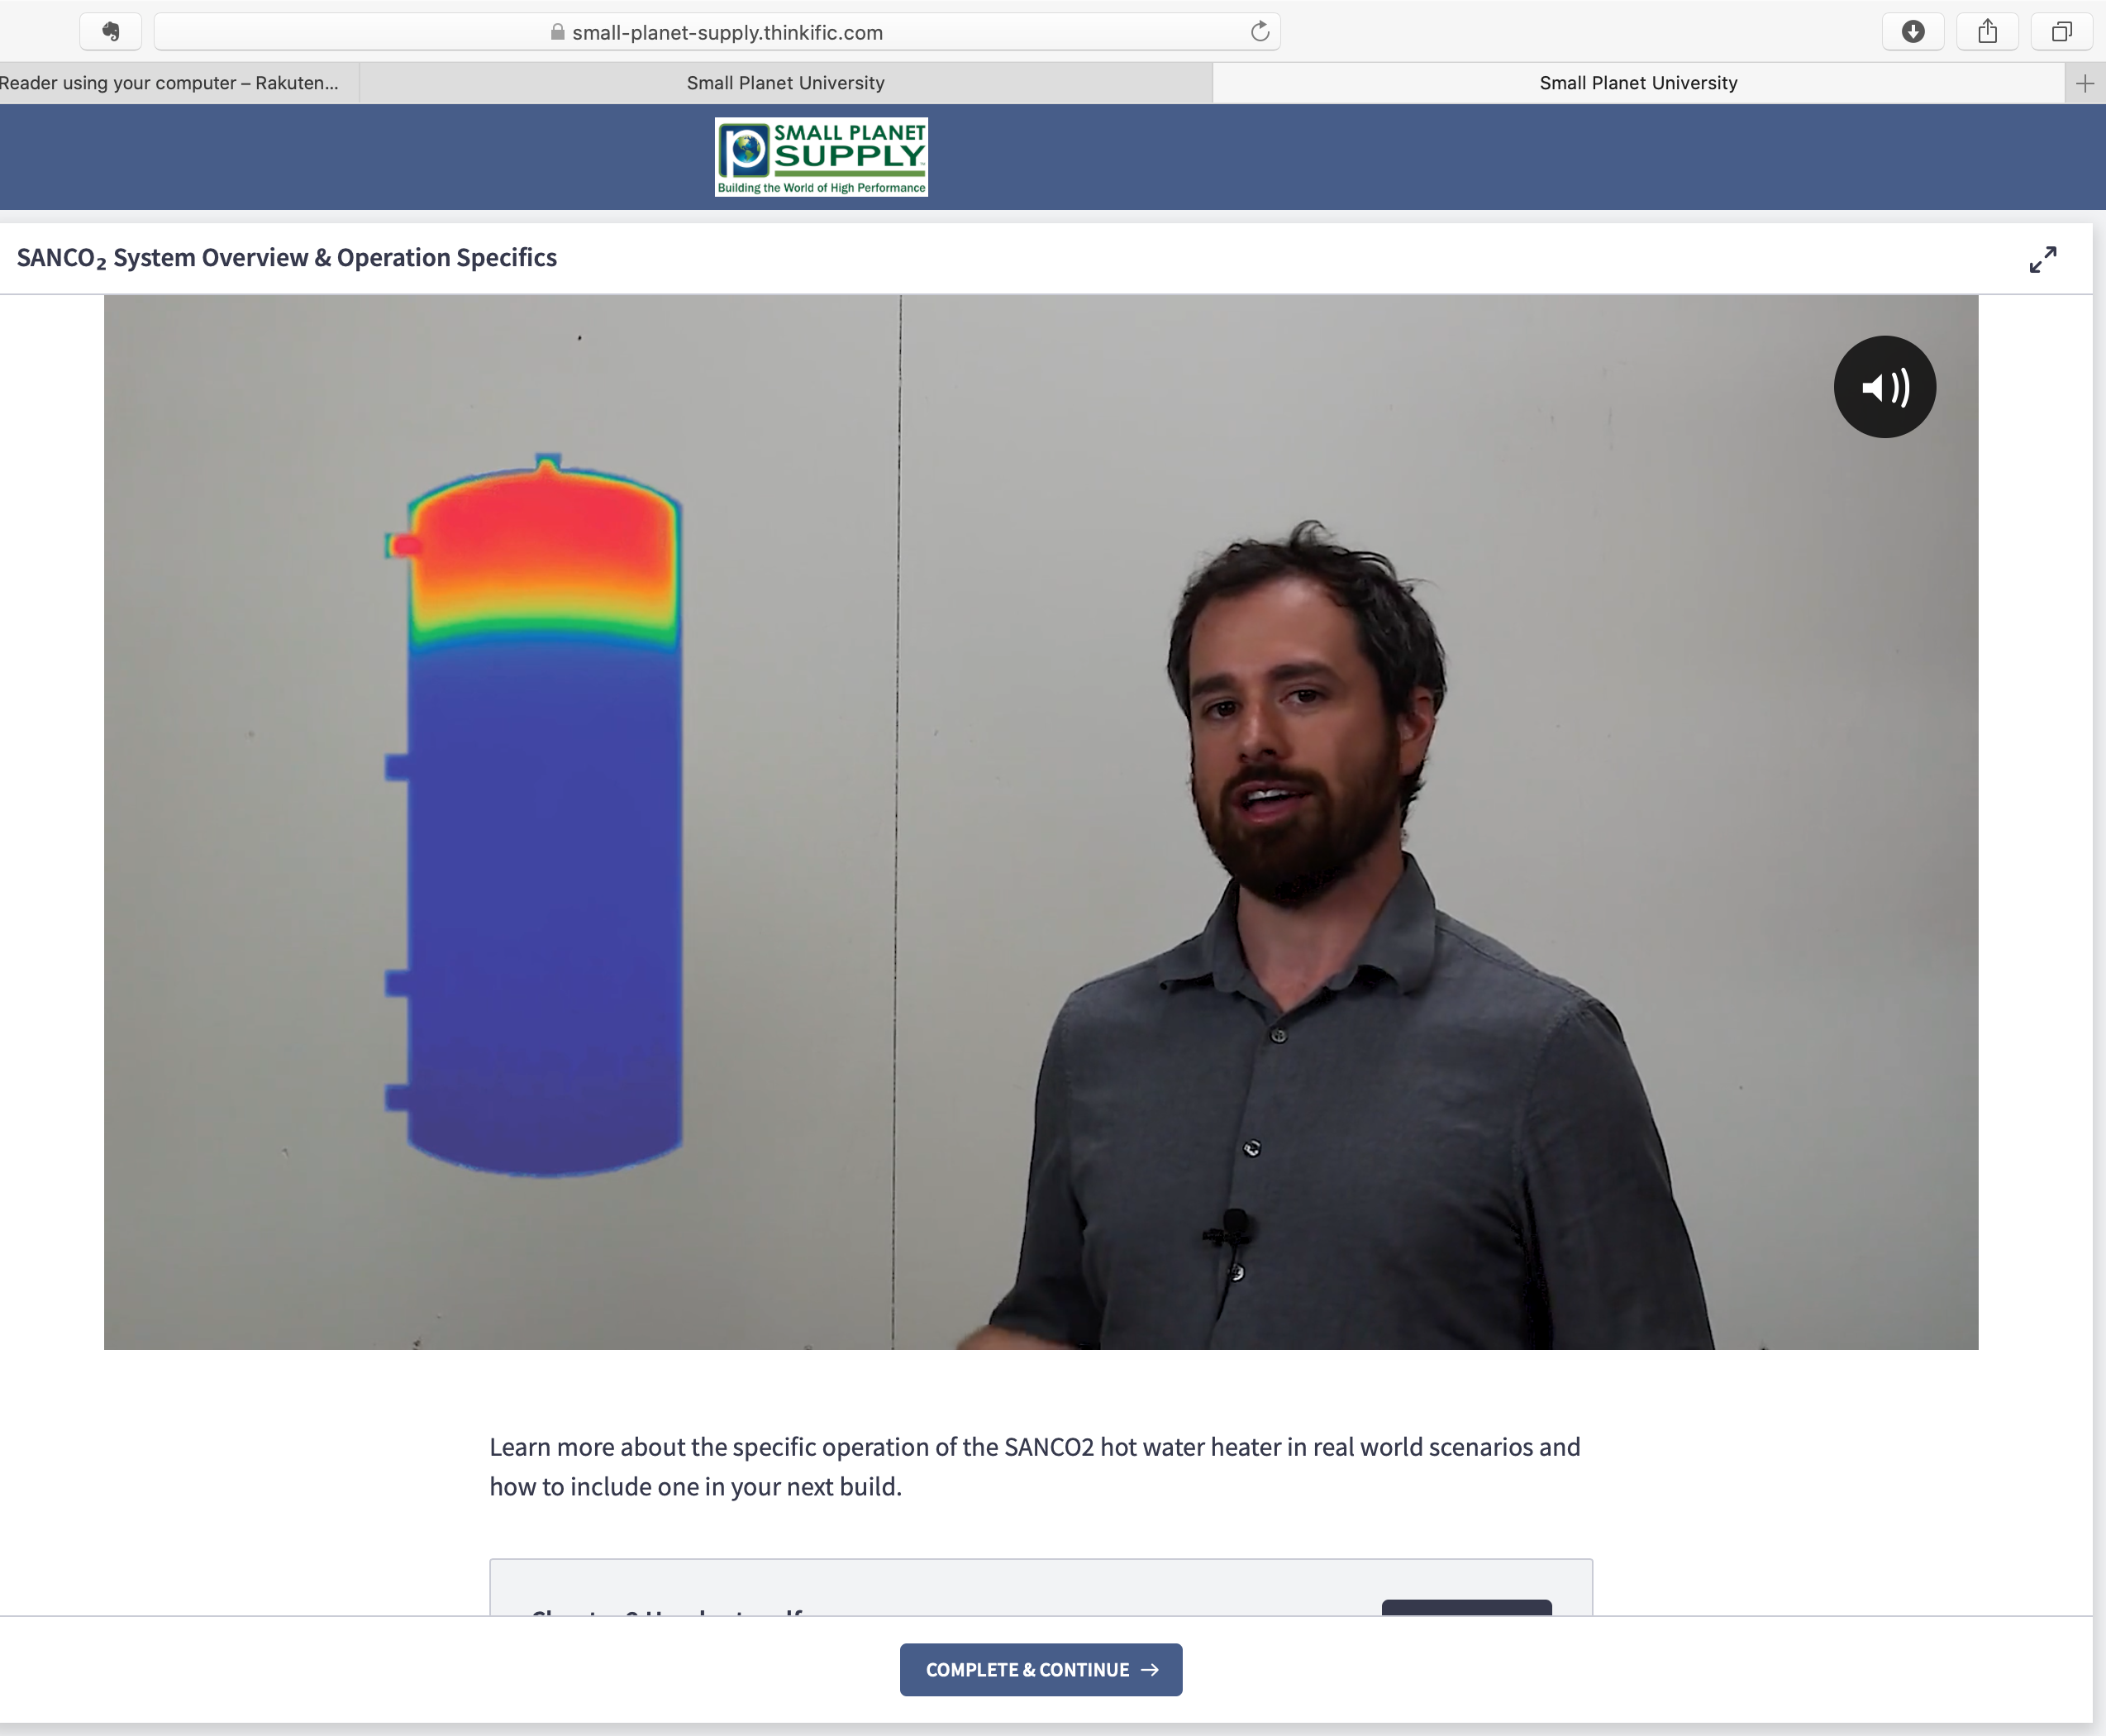
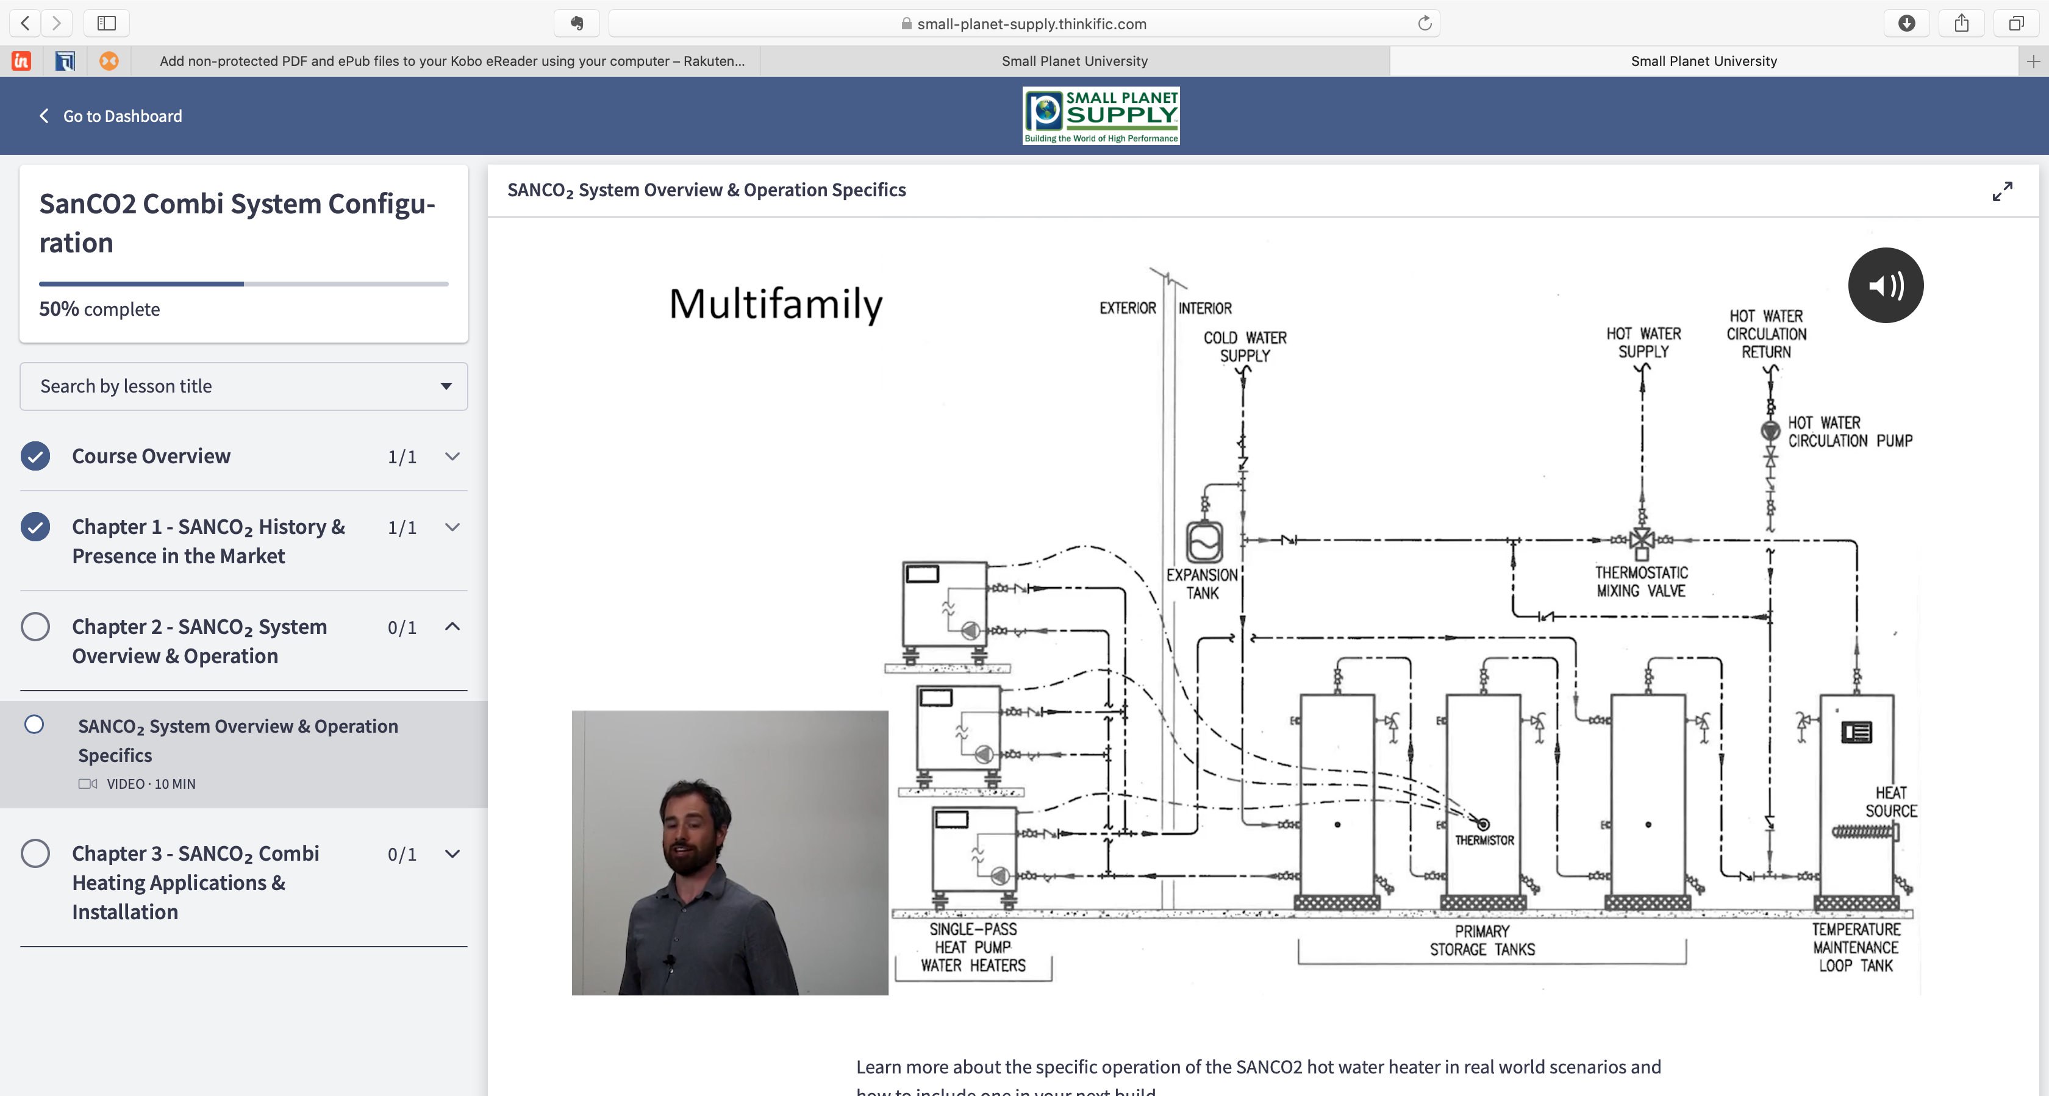
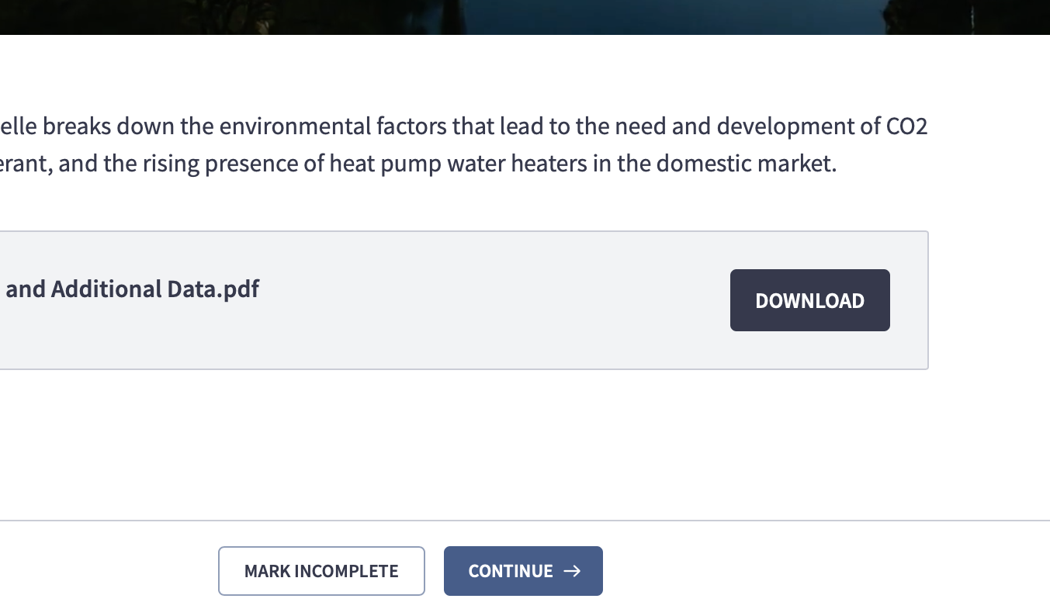
Full Feature Learning Platform
Course broken into chapters
Downloads available

Slide 26

Upcoming Critical Work
  Tool development
    EcoSizer 1.0 – sizing tool
    EcoSizer 2.0 – energy modeling tool
  Critical supporting research
    Temperature maintenance losses
    Different design configurations
  Generic design guidelines and specifications
    AWHS development begins in next quarter
  Code development and alignment
    CA Simulation Engine – integration of HPWH-Simulation
    Developing testing protocol and lab accreditation to validate CTA 2045
  Lab testing for performance maps and applications (PG&E)
    System performance maps
Notes:
Manufacturer
Laars Feasibility
Colmac develop new GWP product
Mits – load shifting
Sanden - new controller
Working w each manufacturers on different steps of the TIM
Itomic, Mayakawa, Daiken
Next time come back to the discussion? What other work is going?
Here is all the work that we are funding and doing. What are you going to do? - Warn this call is coming. Following up w each one of you. What needs to get done to make this real.
Let me know who I should talk to.

Slide 27
Thank you

