Slide 1
Central HPWH Work Group
October 20, 2020

Slide 2
Agenda
What’s New?
Market rate adoptions survey
https://www.surveymonkey.com/r/ET_CHPWH
Ecosizer1.0 Overview and Demonstration
Central HPWHWG Vision, Roadmap, 2021 workplan
End of year funds

Slide 3

What’s New
New projects
Technology and location
New collaboration opportunities
New code, policies or rulemakings
New products

Slide 4


Market Adoption
https://www.surveymonkey.com/r/ET_CHPWH

Slide 5
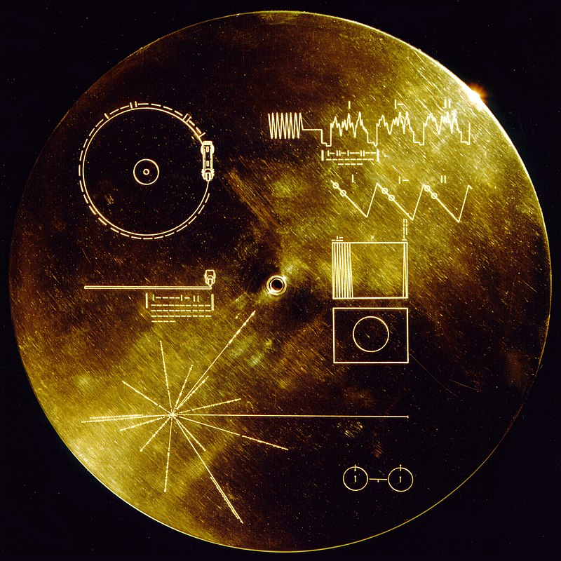

Ecosizer – Multi-Family CHPWH Sizing Tool
10/20/2020
Ecotope
Colin Grist and Paul Kintner
Notes:
Fermi paradox → where are they? → one of countless theories suggests advanced civilization wipe themselves out → war… climate change

Slide 6
Why do we need a sizing tool?
What are we designing to?
Ecosizer Method for sizing.
How to use the Ecosizer.

Slide 7

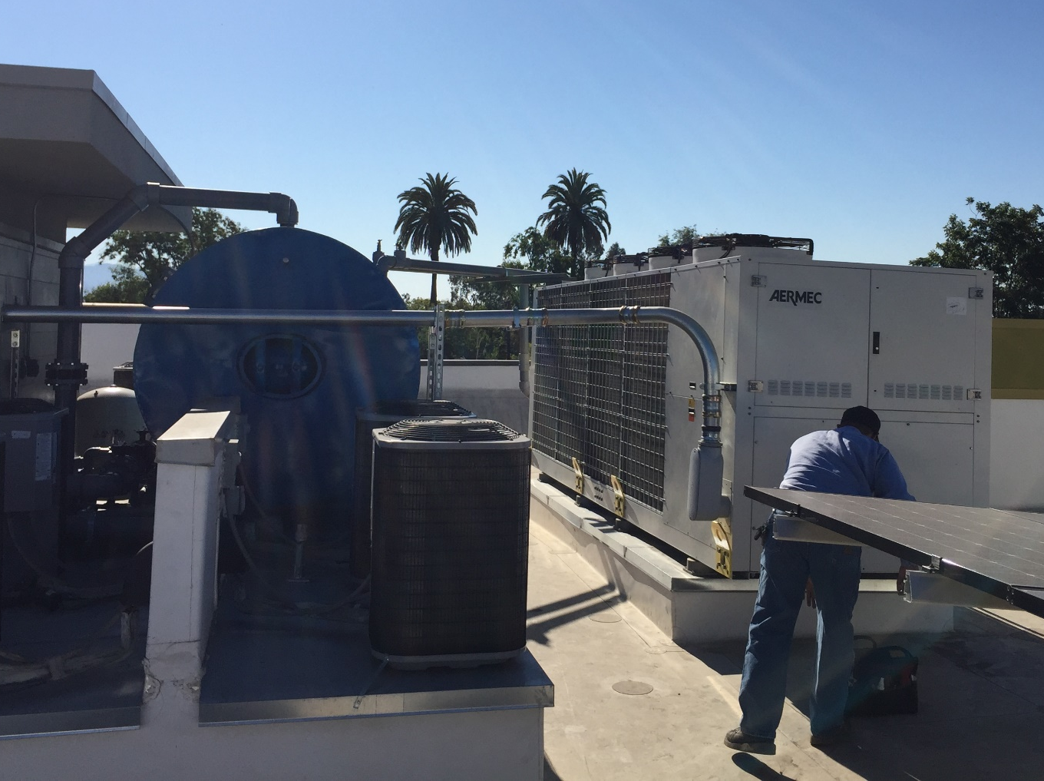
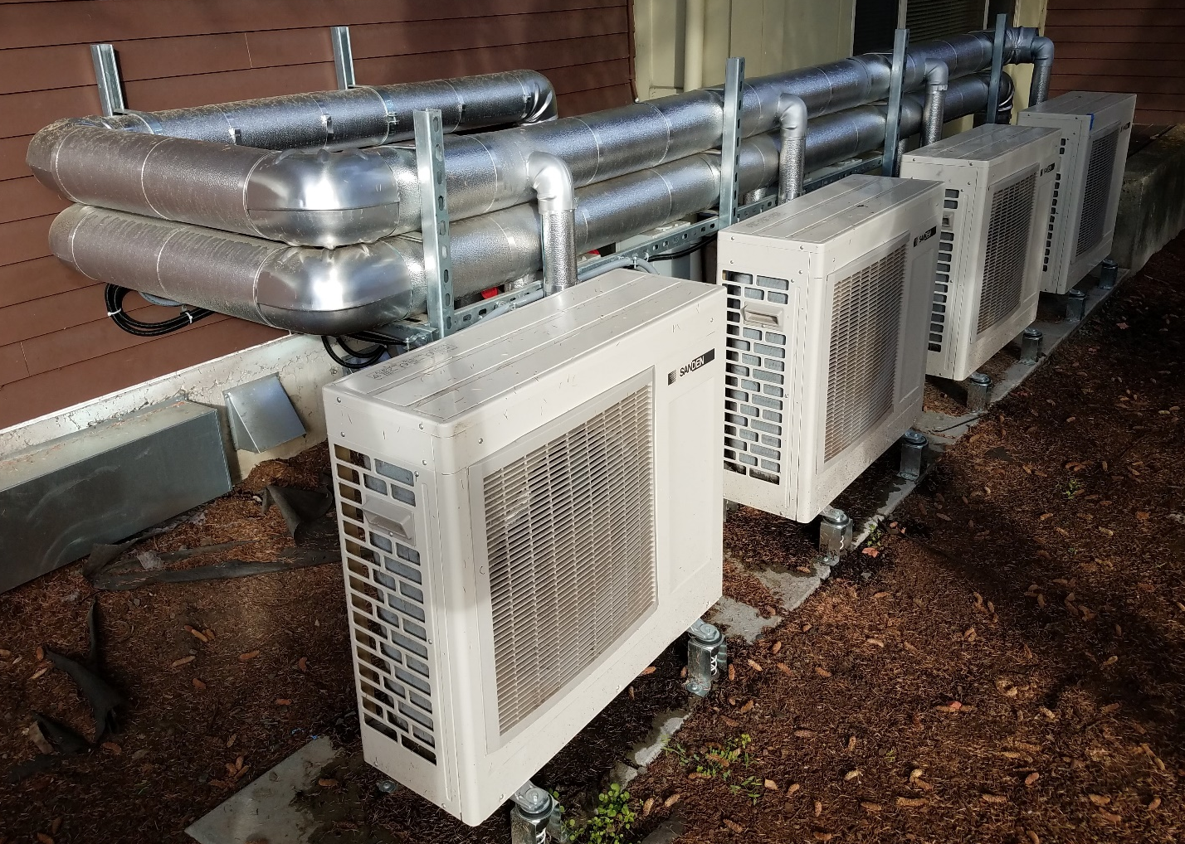
Previous Sizing and Equipment Selection
55 Tons
1,000 Gallons
5 Tons
520 Gallons
Notes:
Older sizing method leads to at least double what is needed.
Oversizing of single speed equipment will result in unstable operation
Oversizing will not result in cost-effective DHW system
Storage is cheaper than capacity.

Slide 8
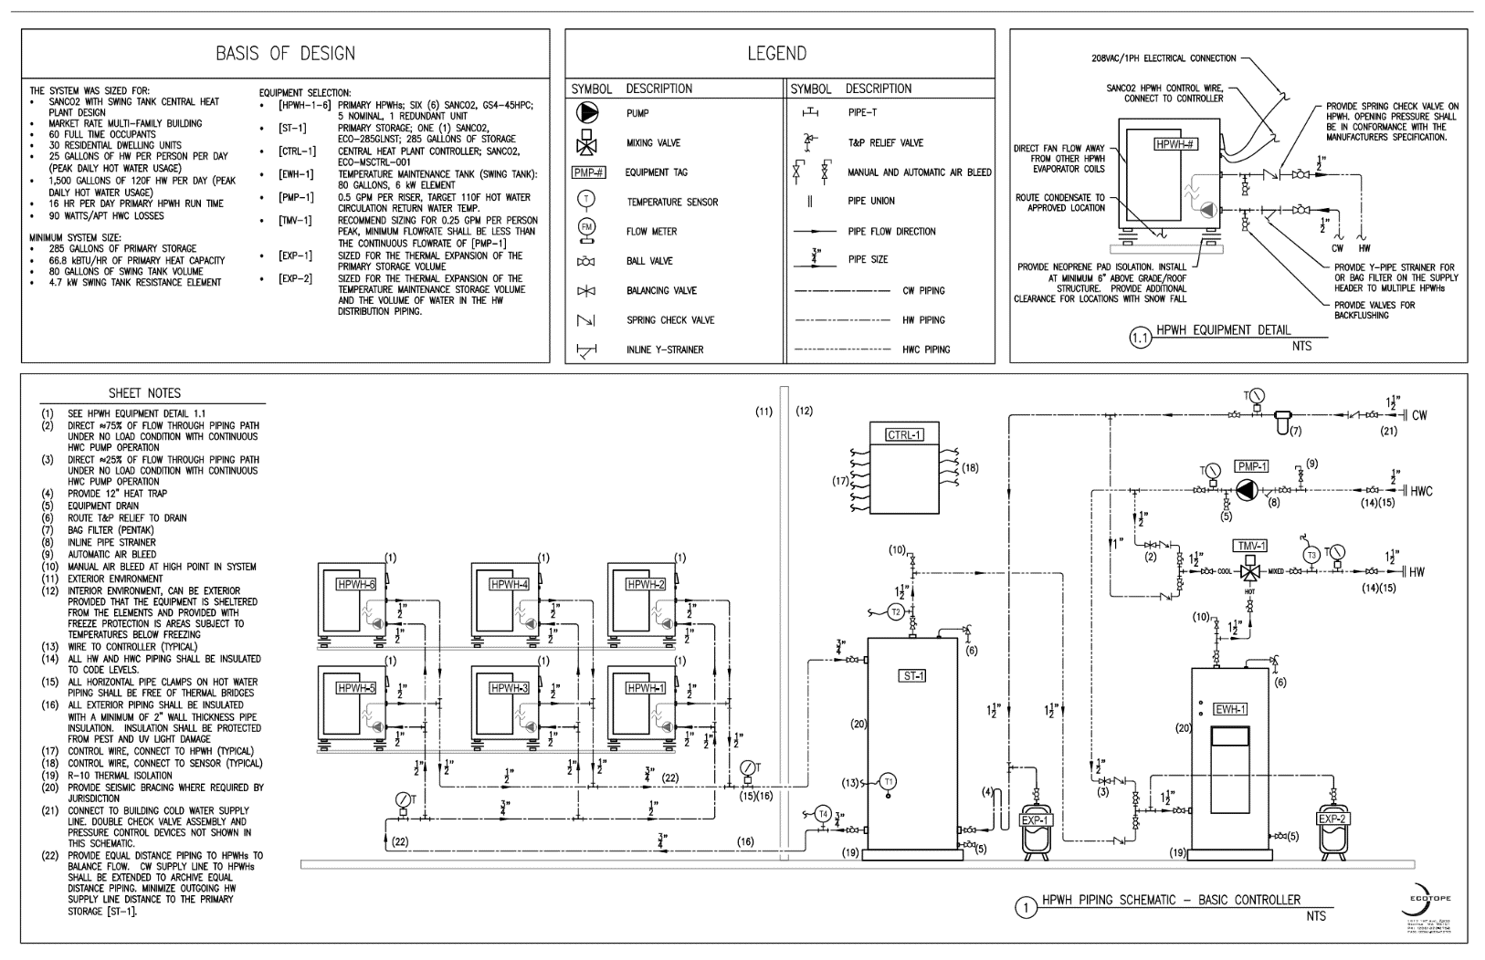
GOALS
Standardize method for all
Remove the mystery behind getting a size from manufacturers
Standardize schematics
Education → Change is hard

Slide 9


Domestic Hot Water Load
Hot water load defined by:
the number of occupants
how much hot water they use
At the Design Conditions (cool temperatures)
Notes:
First step is predicting the hot water load

Slide 10
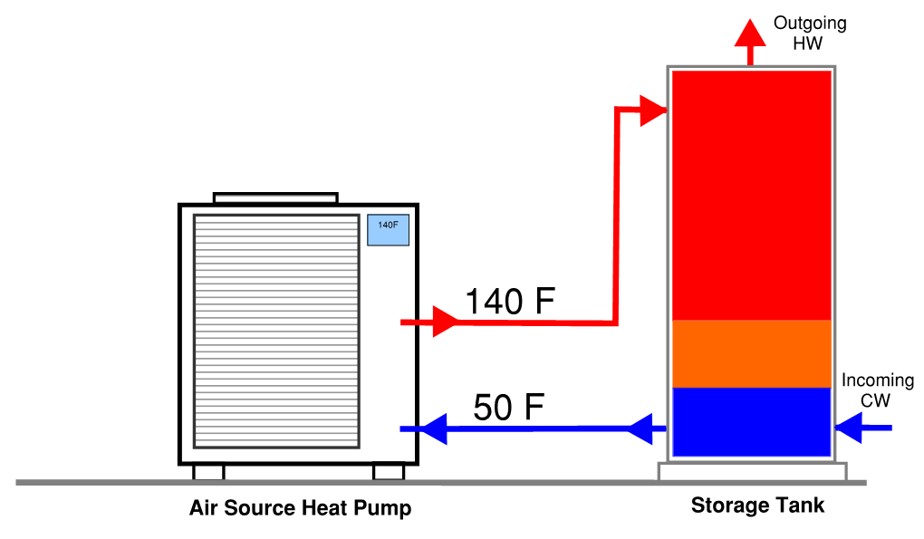
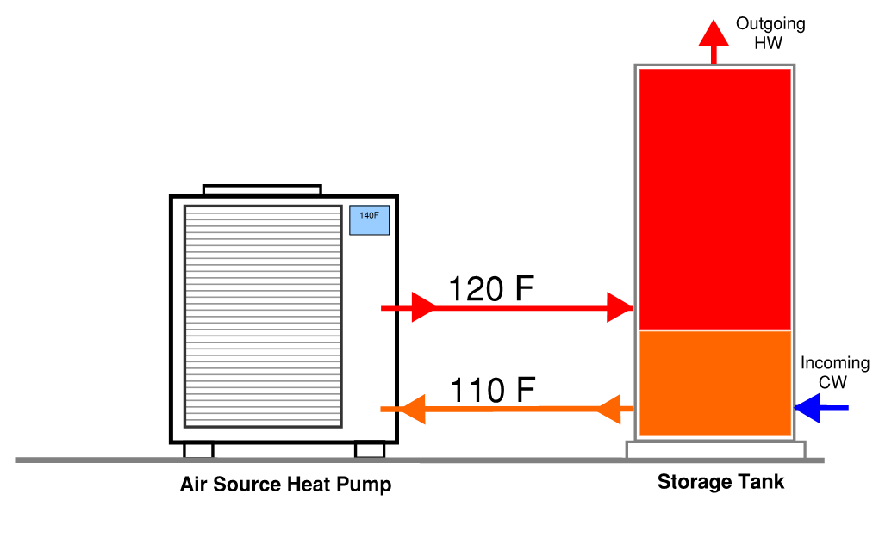
All Heat Pumps Are Not The Same
Single Pass
Heats water to working temp in single pass
Multi-Pass
Heats water to working temp in multiple passes
Notes:
Single-Pass vs. muiltipass require completely different design approaches Shawn will speak more on this.
What is important to understand is single pass heats the water in a single pass (typically a 90F lift)
Where multipass heats water in multiple passes. Typically with a 10F lift per pass

Slide 11

ECOSIZER METHOD
Running Volume
Storage Efficiency
T
Cycling Volume
Aquastat Fraction
Morning Peak
Evening Peak
Idealized Hot Water Storage Tank

Slide 12

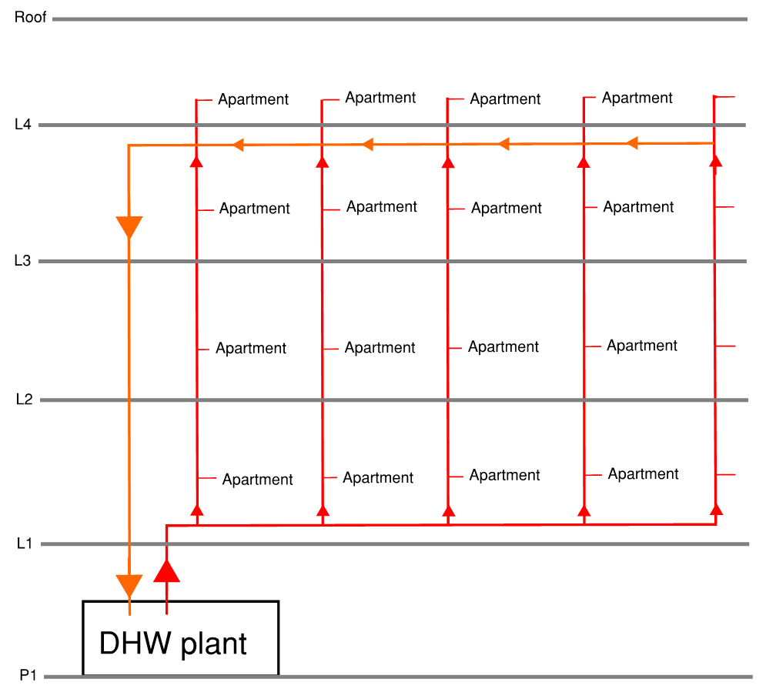
TWO DISTINCT LOADS
Primary Heating:
Heating water for use
Making cold water hot
Temperature Maintenance:
Reheating water due to energy losses in the distribution system
Keeping hot water hot
Notes:
Reheating water due to energy losses in the distribution system
Temperature maintenance is a significant load year-round. Typically it is 30-50% of the heating load!
There are a few options to deal with this, the two primary methods are circulating the water or heat tracing the piping
HW circulation can create issues with heatpump operation if it is not addressed appropriately.
-Averaged ~30% of the total water heating energy or ~10% of total building energy use*.

Slide 13
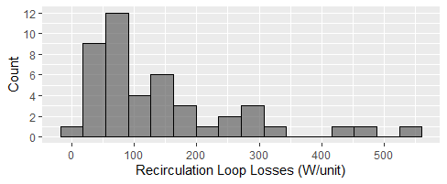
TEMPERATURE MAINTENANCE LOAD
45 measured buildings show variance
Theoretical calculation doesn’t match measured values
Seattle multi-family is typically around 50 – 100 W/apt
Notes:
Next is predicting the temperature maintenance load
Median is 90 W/apt
Average is 175 W/apt

Slide 14

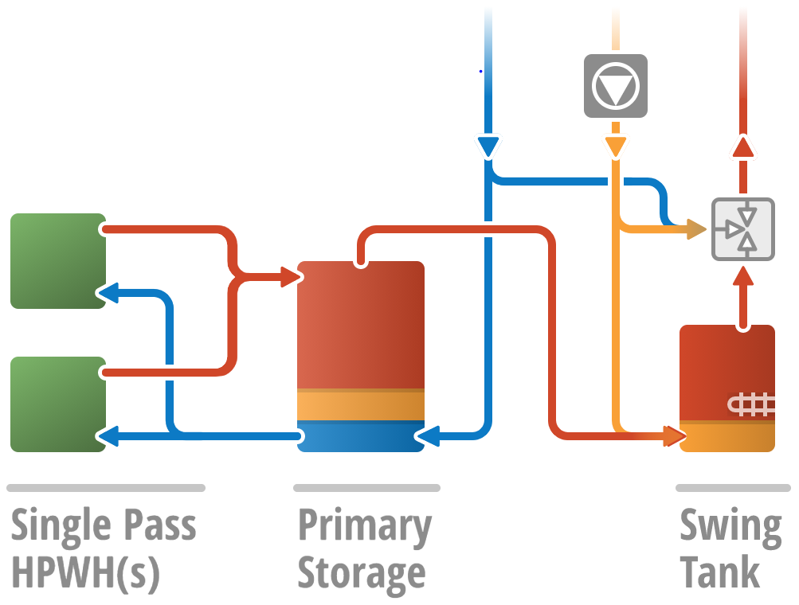
SWING TANK

Slide 15
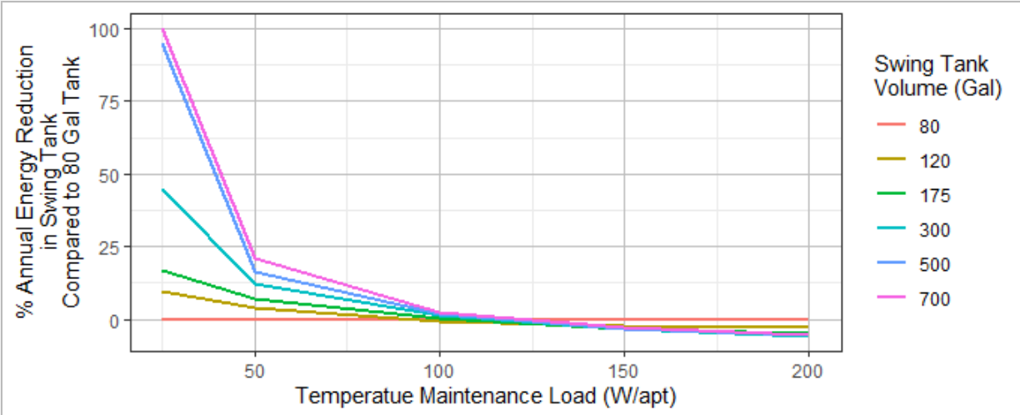
SWING TANK
Swing Tank Volume (Gallons)
Number of Apartments | Ecosizer | Title 24
0 - 12 | 80 | 80
13 - 24 | 80 | 96
24 - 48 | 80 | 168
49 - 96 | 120 - 300 | 288
> 96 | 120 - 300 | 480
Annual simulation of swing tank suggests the increasing the volume of the tank is not very effective at average temperature maintenance loads (~100 W/apt)
Annually offsetting ~50 W/apt

Slide 16

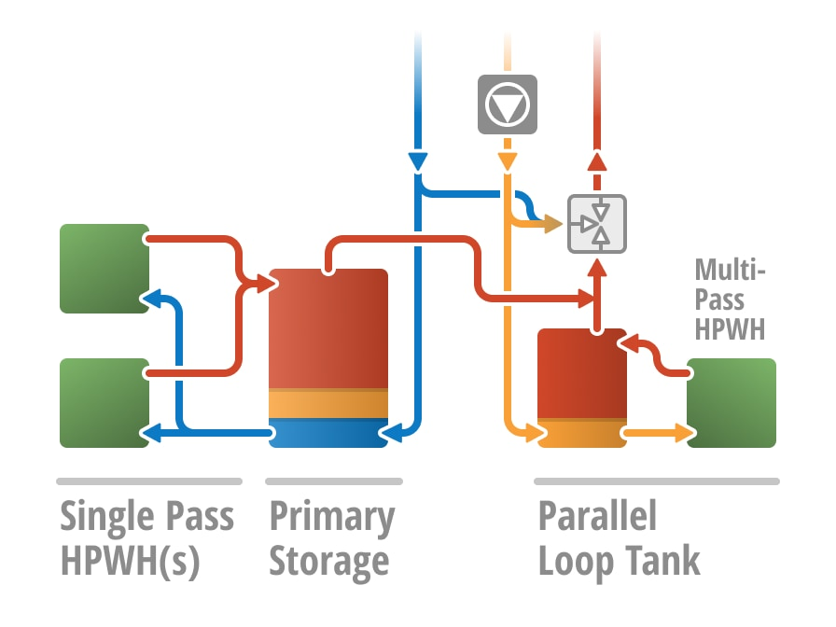
PARALLEL TANK
Constant temperature maintenance load
Design to cycle
On period greater than 20 minutes to prevent short cycling.

Slide 17
LOAD SHIFTING
Same methodology but hot water generation rate goes to zero
Checks that it has enough recovery for the whole after the event
Expand storage volume, but still trades off with heating capacity
Comparison
100 people, 2000 gallons per day
HPWH size to run 20 hours
Scenario | Sized Volume (Gallons) | Heating Capacity kBTU/HR
No Load Shift | 530 | 83
5PM to 9PM | 700 | 83
6AM to 10AM and 5PM to 9PM | 950 | 104
Notes:
For example, in a situation similar to the example worked in Figure EX1 and Figure EX2, if a user sets the load shift period from 1700 to 2000 the assumption is the hot water generation rate goes to 0 during this time period,

Slide 18
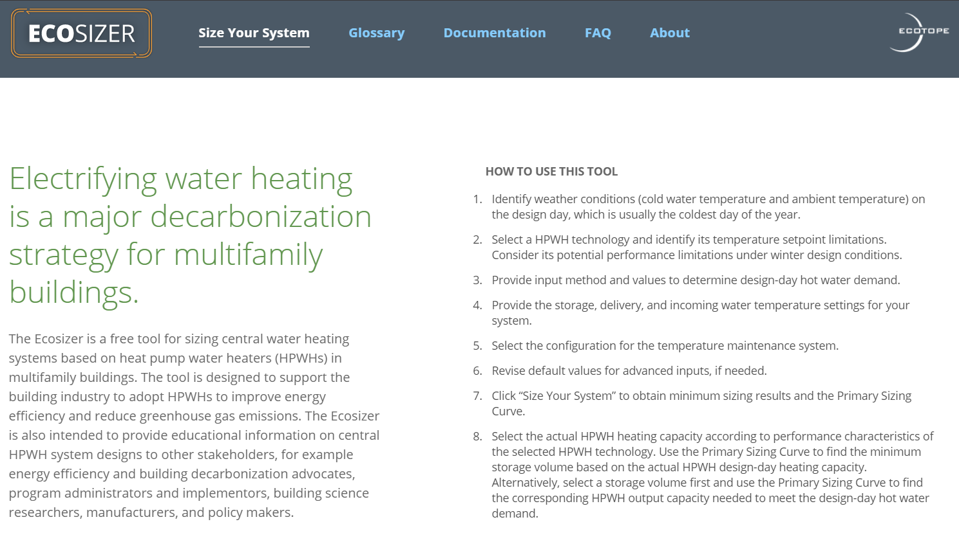


Ecosizer Method

Slide 19
WHAT’S NEXT? ECOSIM
What users are asking for
Equipment selection of different available technologies
Accounting for temperature dependent HPWH performance and defrost by modeling with location-based weather files
Bring in HPWHsim and yearly analysis
Conduct energy performance and sizing analysis.
Easily compare multiple scenarios and trade-offs between tank sizes and HPWHs
Notes:
This is the tool that is needed to compare PERFORMANCE – different products, different configurations, different options, climates, sizing, controls, etc… Needed by designers to optimize their designs. Needed by code officials and utility program people to determine savings from range of products and designs.
So what’s next? Some of the early feedback suggests users want more, they want to be able to select specific equipment from manufactures and see how much volume they need. And they want us to account for the different defrost deratings from manufactures, as well as encompassing location-based weather files, and they want annual performance.
The good news is that we can solve many of these issues from the continual development of HPWHsim, the premier heat pump water heater modeling software used in CBECC-Res. With this software we can model tank temperatures, input power and COP for specific HPWH technologies and weather files, providing annual performance estimates. And this could allow for users to change the tank sizes or heating capacity to see the trade offs in annual energy usage letting them make informed decisions using cost benefit analysis.

Slide 20





THANK YOU
Paul Kintner paul@ecotope.com
Colin Grist colin@ecotope.com
FUNDERS
INPUT

Slide 21
VISION for ROADMAP
Develop a funded 24-month plan/roadmap to develop framework for all new CHPWH systems being non-fossil
OPPORTUNITIES - END STATE
CODES/INCENTIVES
PROVEN PRODUCTS AVAILABLE
MARKET KNOWS & DESIRES PRODUCT
Sticks. Codes etc require or encourage HPWH Carrots. Utility programs/community-based choice aggregators provide incentives … cost-effective
Collaborative process that encourages and proves proven systems Local suppliers readily have plug-n-play systems available
Market actors know how to design, install and commission systems Market actors are aware and desire the systems
ACTIVITIES / INTERVENTIONS
Advanced Water Heater Spec is available Comment on new codes Develop Model Code Develop Model Incentive Program Credits for modeled systems performance Assist others in development of incentive program EE, Decarb, Grid Interaction Model gas ban Model cost-effective designs for modeled codes
4-5 proven plug-n-play systems Supply chain is trained TIM knowledge development system
Designers/Architects (market actors) are trained and choose to install systems Trades are trained and are comfortable installing systems Operators trained and operations and can optimize the system for performance and load flexibility
High Performance: Low GWP (<700) High Average System Efficiency (C0Psys~3) Grid Responsive

Slide 22
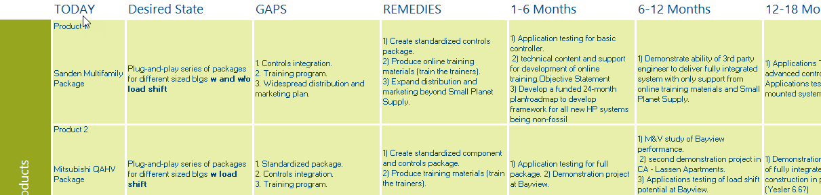
Sample 2021 Work Plan

Slide 23
ASK:
Does this seem about right?
Join team and contribute expertise or interests
Continue vision development
Develop workplan
Next Steps

Slide 24
End of Year funds
Several project that need funding
Training
Spec development
Market assessment
Needs assessment
… other priority items?

