Slide 1



BONNEVILLE POWER ADMINISTRATION
Summer Learning Series
Webinar 2 of 3 | June 24, 2021
Notes:
Photo by Matej Sefcik on Unsplash

Slide 2

Org Name
+
Summer Escape:
Beach or Mountains?

Slide 3


ADJUSTABLE SPEED DRIVE MARKET ACTOR INTERVIEWS
FINDINGS AND KEY TAKEAWAYS
Notes:
This research is the first work BPA has undertaken to characterize the Adjustable Speed Drive Market. BPA completed this research in 2020, and over the course of this next year will be applying these findings, along with other market information to model the impact ASDs have on the industrial energy consumption of pumps and fans.

Slide 4
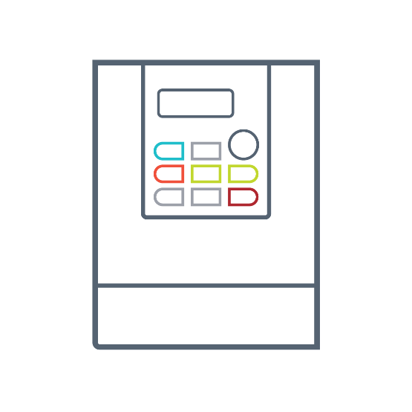


WHY WE CONDUCTED THE INTERVIEWS
Electric motors are a big energy end use
Motors and ASDs are an under-characterized market
Everyone is thinking about motors and ASDs
BPA Market Research Team is working to model industrial pump and fan energy consumption, and the impact of ASDs on those systems in the region
Notes:
We want to spend the majority of the presentation discuss findings from the research. We take a little time at the beginning to provide some background on why we are researching this market and how we approached this research, then dive right into the findings.
With this being the first market investigation from BPA, the findings are very broad ranging.
There are three big factors driving BPAs market research into motor driven systems and ASDs:
Electric motors represent a huge energy end use in the region:
In the industrial sector alone, motors consume approximately 70% of the industrial energy. BPA investigated ASDs because, as a technology, they have the potential to dramatically decrease motor energy consumption.
Motors and ASDs are an under-characterized market
At both a regional and national level, there isn’t a wealth of knowledge about the motor and drive market. The Department of Energy has completed 2 market assessments, but these reports were published 20 years apart. This puts BPA in a great position to add necessary information to the knowledge-base.
Everyone is thinking about ASDs
There is a lot of interest in the region around the impact of ASDs. NEEA’s XMP Initiative, RTF measures, and 2021 Power Plan all address the energy savings of ASDs. These research, and the model development work BPA is conducting right now, will provide market insights for all of those activities.
Because there isn’t a lot of existing information on these markets, a lot of our findings are research implications. BUT, we want to be clear that by no means is this just about research implications. We're curious and welcome program folks to chime in and discuss what they take away from these findings. How does the overall market differ or is similar to program?

Slide 5



WHO DID WE INTERVIEW?
This research aimed to characterize the ASD market from all different levels
Production
  Motor & ASD Manufacturers
  Motor & ASD Distributors
  OEM & OEM Manufacturers
  Engineering Service Firms
  Program Implementers
End User
Notes:
The research targeted 5 different market actor categories:
Manufacturers
Distributors
OEM and OEM distributors (these are the companies that manufacture the equipment motors drive, like pumps or fans)
Engineering service firms, and
Program implementors
We targeted these market actors because we wanted insight from different levels to develop a full picture of the market. In total, the team interviewed 53 market actors across these categories.

Slide 6

RESEARCH FINDINGS

Slide 7






RESEARCH FINDINGS
Motor & ASD Supply Chain
Installation & Operating Trends
Equipment-Specific Findings
ASD Adoption
Notes:
Our findings from this research can be broken down into four different groups:
Findings that informed our understanding of the Motor and ASD Supply Chain
Information on ASD adoption and how it has changed over time
Installation and operating trends for motors and ASDs, and
Equipment-specific findings, focused on trends in different equipment in relation to ASDs

Slide 8

RESEARCH FINDINGS
Motor & ASD Supply Chain
Installation & Operating Trends
Equipment-Specific Findings
ASD Adoption
Notes:
We are going to start in on the Motor & ASD supply chain.

Slide 9





Motor
Manufacturers
&
ASD
Manufacturers
Motor & ASD Supply Chain
Engineering Service Firms (Influencer)
Distributors
(Local and National)
OEM and OEM Distributor
Installing Contractor (Mechanical Contractor)
Controls/ Commissioning Contractor (Influencer)
End Users
Residential buildings
Commercial buildings
Industry/ Agriculture
Notes:
Through this research, BPA developed a supply chain for motors and ASDs. As this graphic shows, the path motors and ASDs take to market is pretty complex. We went into these interviews with a draft supply chain and worked with market actors to refine both the roles that are present in the supply chain and the size of the arrows. We made several updates and refinements to the supply chain. We will go through more detailed findings in the next couple slides, but from a high level, these interviews identified 4 paths to market for motors and ASDs:
Directly from the manufacturer to the end user. Market actors indicated that this is a very small portion of equipment in the region.
From manufacturers to the installing contractor. While a larger portion of the market, the interviews indicated that the last two paths, through distributors and through equipment manufacturers, were how the bulk of units make it to market.

Slide 10
Motor
Manufacturers
&
ASD
Manufacturers
Motor & ASD Supply Chain
Engineering Service Firms (Influencer)
Distributors
(Local and National)
OEM and OEM Distributor
Motors and ASDs are manufactured by the same companies, but the supply chains are vertically isolated at the manufacturer level.
Installing Contractor (Mechanical Contractor)
Controls/ Commissioning Contractor (Influencer)
End Users
Residential buildings
Commercial buildings
Industry/ Agriculture
Notes:
At the highest level, motor and ASD manufacturers identified that there is some siloing that occurs at their level. While the majority of companies that manufacture motors also manufacture ASDs, those two businesses are vertically isolated within most companies. Manufacturers rarely pair and sell motors and ASDs at their level, with these units entering the market separately.
A few manufacturers noted that equipment regulation in Europe requiring an ASD is driving European manufacturers to integrate their businesses, but that transition is slow and hasn’t been seen to impact the US.

Slide 11
Motor
Manufacturers
&
ASD
Manufacturers
Motor & ASD Supply Chain
Engineering Service Firms (Influencer)
Distributors
(Local and National)
OEM and OEM Distributor
ASDs can take two paths to market:
Sold from the OEM with equipment
Sold to the installing contractor/end user and paired with equipment at installation
Installing Contractor (Mechanical Contractor)
Controls/ Commissioning Contractor (Influencer)
End Users
Residential buildings
Commercial buildings
Industry/ Agriculture
Notes:
As motors and ASDs leave the manufacturer, there are two main paths they can take to market:
They can be sold together with the equipment to the installing contractor of end user. Or
ASDs can be sold separate from the motor and equipment, then paired at installation.
This split in the path to market makes it more difficult to characterize the flow of motors, as they can make it to the end user in multiple different ways.

Slide 12
Motor
Manufacturers
&
ASD
Manufacturers
Motor & ASD Supply Chain
Engineering Service Firms (Influencer)
Distributors
(Local and National)
OEM and OEM Distributor
Installing Contractor (Mechanical Contractor)
ASDs are most often paired with motors and equipment at installation.
Controls/ Commissioning Contractor (Influencer)
End Users
Residential buildings
Commercial buildings
Industry/ Agriculture
Notes:
Market actors indicated that of the paths that they could take to market, ASDs most often paired with motors and equipment at installation, either by an installing contractor or by the end user. This again increases the complexity of understanding how ASDs are applied, as collecting information at the end-user level is difficult and resource-intensive.
Pause for questions
One thing to note on this map are the influencers identified in white. These organizations don’t directly interact with the supply chain (that is, they don’t sell or purchase equipment), but they can influence the type of equipment that makes it to the end-user.
Examples of each market actor category.
Motor Manufacturers
ABB, NIDEC
ASD Manufacturers
ABB, WEG
Distributors
Grainger, Dykman Electrical
OEM and OEM Distributor
Greenheck Fans, Grundfos Pumps
Engineering Service Firms
McKinstry, Wildan Group

Slide 13


RESEARCH FINDINGS
Motor & ASD Supply Chain
Installation & Operating Trends
Equipment-Specific Findings
ASD Adoption
Notes:
Next we will look at the findings focused on ASD adoption and how it has changed over time.

Slide 14






ASD ADOPTION
Almost all market actors indicated an increase in the rate of adoption of ASDs in the region
  Not only is the number of ASDs in the region growing, but the rate at which they are being adopted is increasing
Notes:
Almost all the market actors we interviewed indicated that the rate of ASD adoption is increasing in the region.
This means that not only is the saturation of ASDs increasing each year, but adoption is accelerating. Market actors indicated multiple different causes for this increase in adoption, including better understanding of the technology, more insight into the potential energy savings, and a desire for system connectivity (which ASDs provide).
This shows future potential for savings from ASDs

Slide 15


ASD ADOPTION
Electronically driven mechanical control devices, like eddy current drives and hydraulic drives, are rarely installed in the field
This niche equipment control strategy does not make up a measurable portion of the current sales
Notes:
We asked market actors about control devices other than ASDs in the market, like eddy current drives or mechanical gear boxes.
While both types of control devices vary the system load, ASDs decrease the speed of the motor to facilitate this control, whereas mechanical control devices serve to decrease the speed of the equipment. Mechanical control devices see less energy savings than ASDs, as they do not directly impact the motor.
Market actors indicated that these electronically driven mechanical control devices are very rarely installed in the field. They serve very niche applications in heavy industry settings.
This information helps inform the market model BPA is working on right now. Accounting for the relationship between power consumption and system load is important in understanding motor energy consumption, and this finding indicates that these types of control strategies don’t need to be prioritized in the model.

Slide 16

ASD ADOPTION
ECMs are the only advanced motor technology with a measurable share of the standalone motor market, and is growing
  Accounting for the impact of ASDs requires looking at integrated ASDs in ECMs
Notes:
Electric motor technology is not new, but the field, like any, is constantly investigating and improving on its offerings. There are currently multiple different types of “advanced” motor technologies starting to make their way into the market. The motors have high efficiencies than traditional motors, and often have the ASD integrated into the motor.
At this point in time, Electronically Commutated Motors, ECMs, are the only advanced motor technology with a sizeable portion of the market. These motors range from fractional to approximately 30 motor HP, and have become very common in embedded applications. That is, as components of larger, built up systems like commercial refrigeration systems.
BPA’s current market model is focused on industrial standalone pumps and fans, so from a practical perspective while the current market model may not need to account for these motors, any investigation into commercial ASDs needs to account for these advanced motors.
Pause for questions.

Slide 17



RESEARCH FINDINGS
Motor & ASD Supply Chain
Installation & Operating Trends
Equipment-Specific Findings
ASD Adoption
Notes:
While the interviews were focused on charactering the market, we were in a position to ask questions of market actors with experience in operation and installation for these equipment.

Slide 18
INSTALLATION &
OPERATING TRENDS
Approximately 15% of ASDs serve trim applications
Load Matching
Equipment Right-Sizing
Operating Hours
Percent of Max Load
Notes:
A big finding from these questions focuses on the type of application ASDs see. In general, ASDs can serve two main purposes:
They can allow a piece of equipment serving a very variable load to efficiently meet that load. The controllability of an ASD allows a piece of equipment to react automatically based on a change in demand.
ASDs can also help right-size equipment that operates on constant load systems. Motor driven equipment is commonly oversized as a way to build in flexibility in a system, but this means they system then has to be throttled back to meet the required demand. Right-sizing with an ASD is more efficient than with mechanical control strategies.
These applications are differentiated because the potential for energy savings is different between the two. Both facilitate energy savings, but load matching offers much larger savings than right sizing
We wanted to pause here and open-up for discussion. For those who work with these equipment in programs, does this align with what you see in the field?

Slide 19
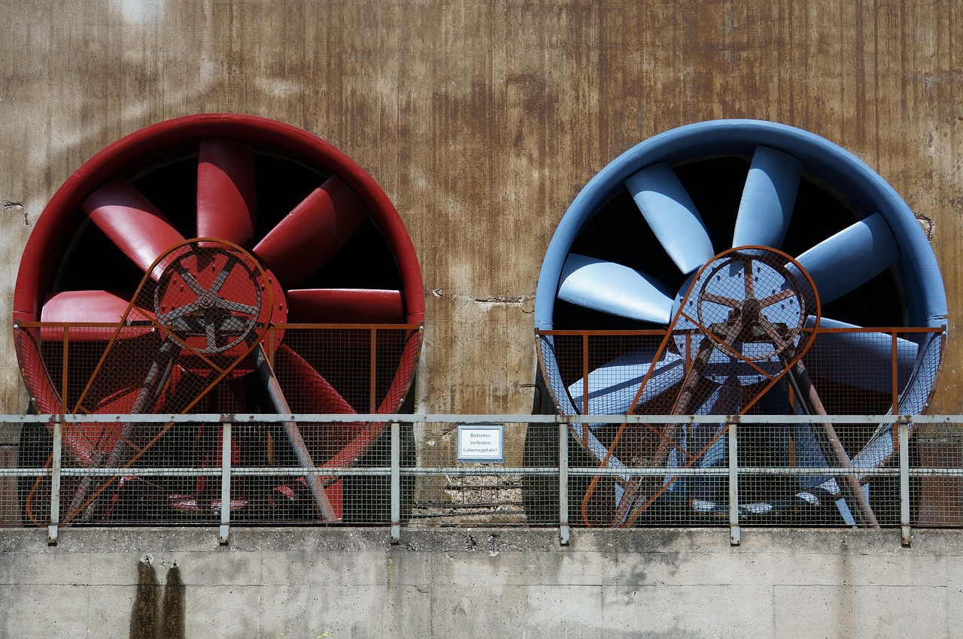

INSTALLATION &
OPERATING TRENDS
All standalone commercial fan applications (Clean Air Ventilation and Exhaust) have similar operating characteristics
  Only one commercial application is needed to characterize standalone commercial fan operation
Notes:
Standalone commercial fans serve two main applications: clean air supply and exhaust. Interviewees indicated that these two applications will see similar operating hours and load profiles, as they will be serving the same buildings and operating patterns.
In characterizing energy consumption of motor driven systems, load profile and operating hours are the two variables with the largest impact. This finding indicates that any research or modeling on commercial standalone fan systems can treat these two applications as one, decreasing any research burden and model complexity.
In addition to less research burden, this information can potentially serve to streamline programs on commercial fan systems, shrinking the work on program verification and evaluation for these systems.
Picture source: https://pixabay.com/photos/industry-ventilation-metal-2182767/

Slide 20


INSTALLATION &
OPERATING TRENDS
There is a large gap in knowledge around ASD commissioning
There was no consensus on the portion of ASDs that undergo commissioning or which market actor leads commissioning of ASDs
Notes:
The third installation trend we identified was less of a finding, and more of a lack of findings. We discussed commissioning with market actors in every category, and few were able to address this topic, and the market actors who were able to provide insight provided conflicting information. Understanding commissioning practices is necessary to understand the amount of realized savings from ASDs. Getting an ASD installed is a great first step, but it also has to be used to control the system, and commissioning supports that.
We weren’t able to identify a consensus around what portion of the ASD market underwent official commissioning, and different market actor categories were identified as the agent responsible for commissioning the equipment. Saying there was finger pointing would be going too far, but it was obvious that each market actor sees it as someone else’s responsibility.
This confusion may be because, in the end, the end-user is responsible for making sure the equipment is commissioned. Or possibly the path to market impacts the responsible party, with installing contractors responsible when purchased through them and end users responsible when purchased directly from the manufacturer.
The main takeaway from our questions on commissioning is that the region may need more research on motor-driven system and ASD commissioning to understand trends on this topic.

Slide 21

RESEARCH FINDINGS
Motor & ASD Supply Chain
Installation & Operating Trends
Equipment-Specific Findings
ASD Adoption
Notes:
Equipment Specific Findings: We have 2 major findings focused on specific equipment

Slide 22

AIR COMPRESSOR TRENDS
Large commercial air compressors are decreasing in prevalence
Compressed air systems are not being installed in new commercial buildings, and are being replaced with digital control systems in existing buildings
Notes:
The equipment-specific trends focus on the application of ASDs on air compressor systems. Historically, these systems were imperative to any large facility or building. Not only do they serve process-driven needs, but they also served pneumatic controls systems in commercial buildings.
Over the past decades, electronic control systems in buildings have become more and more prevalent, decreasing the need for large air compressor systems in commercial facilities. Market actors noted that they are seeing fewer and fewer large commercial compressed air systems. In new construction buildings, owners opt for digital control systems. And in existing buildings energy efficiency audits often recommend replacing compressed air systems with electronic controls.
I want to take a second and open this up to people on the call that work with these systems in the field. Does this align with what you are seeing in commercial buildings?
This indicates that there is little potential for future energy savings from ASDs on large air-compressor systems in commercial facilities.

Slide 23
AIR COMPRESSOR TRENDS
Air compressor OEMs only sell their equipment as packaged units, with the motor, air compressor, and ASD as one unit.
There is one main sales path for ASDs installed on industrial compressed air systems: packaged and sold with the air compressors equipment
Notes:
While the use of air compressors is decreasing in commercial applications, air compressors still are still being installed on industrial applications. We interviewed air compressor distributors and program implementors with experience in air compressor systems, and they noted that newly installed ASDs for compressed air systems have a much more consolidated path to market.
While in the past ASDs were retrofitted onto air compressors in the field, manufacturers no longer sell compressed air systems to have an ASD retrofitted. Interviewees indicated that if a new air compressor has an ASD installed with it, the motor, ASD, and air compressor are all packaged at the manufacturer.
With one less sales path to characterize for Air Compressors, characterizing the impact of ASD adoption on these equipment will be more straightforward than for other equipment.

Slide 24
QUESTIONS?
Joan Wang
jjwang@bpa.gov
Link to full report:
https://www.bpa.gov/EE/Utility/Momentum-Savings/Pages/Adjustable-Speed-Drives.aspx
Notes:
That concludes our findings from these market actor interviews. I want to pause here for any questions.
These interviews provide some great insight into a very complex market, helping BPA’s market research team refine their approach to modeling energy consumption. And as with any research, these interviews served to help identify other market research questions to focus on.
Please reach out to Joan and the Market Research Team if you have any questions on this presentation or ASDs in general.

Slide 25

Thank you!
Upcoming Dates & Topics:
8/4, 9-10 AM – Quarterly Call
9/8, 9-10 AM – Non-Res Lighting Sales Data
https://www.bpa.gov/EE/Utility/Momentum-Savings/Pages/Calls.aspx
Notes:
Photo by Markus Spiske on Unsplash

