Slide 1
Daily Demand Voltage Reduction
Refreshing a pilot voltage control program

Slide 2
Outline
Background and Daily DVR Overview
Previous Barriers
New Solutions
Next Steps

Slide 3
BPA’s Daily DVR and CVR Team
Executive Sponsorship
Dave Moody
Engineering
Planning & Evaluation
David Tripamer
Tony Koch
Frank Brown
EERs
Brice Lang
Indicates Speaking Today

Slide 4
Product Overview and Background
Why this is so beneficial and what led to this

Slide 5
Resources are More Expensive
Conservation is getting harder and more expensive to achieve.
Most conservation measures are not targeted to utilities’ actual resource constraints.
Utilities are facing pressures to keep rates low.
Utilities will face increasing Tier 2 exposure and higher power prices.

Slide 6
Low-Cost Resources and High Benefits
Daily Demand Voltage Reduction (Daily DVR) and Conservation Voltage Reduction (CVR) are some of the lowest-cost resources available.
They produce high aMW/yr savings and significant BPA bill savings.
Easy way to spend EEI dollars.
Targeted to utilities’ specific needs.
Benefits increase post-2028 as demand charges increase and for utilities making Tier 2 purchases.

Slide 7
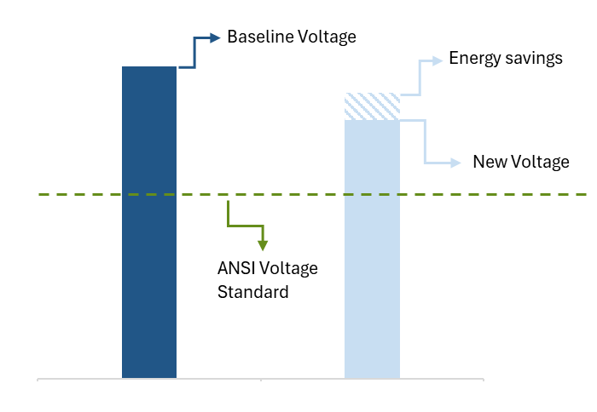
What is Voltage? Why Do We Control It?
Voltage is potential energy, which means, more voltage → more energy use
Many devices use electricity based on the amount of voltage provided.
Utilities must deliver voltage to end-users at certain levels (i.e., ANSI standards).
Utilities deliver voltage higher than is required to ensure reliability.
Reducing voltage produces energy and demand savings for some end-uses.

Slide 8
The Evolution of Voltage Control (1 of 3)
To understand Daily DVR, we first need to understand DVR
DVR is a demand response (DR) product.
Several BPA utilities in the ‘80s and ’90s lowered their voltage during high-need times to meaningfully reduce demand.
DVR generally lowers voltage a moderate amount (3-5%).
DVR is one of the cheapest DR products available.
End-users don’t notice DVR.

Slide 9
The Evolution of Voltage Control (2 of 3)
After DVR came CVR, an energy focused product
CVR is a longstanding energy conservation measure.
CVR reduces end-of-line voltage a little bit (1-2%) for all hours of the year, for 10 years.
CVR produces substantial energy and demand savings.
BPA gives utilities a $0.33/kWh incentive for CVR in year one, which can be very large.
CVR has had minimal uptake as lost revenue drives down net benefits in later years.

Slide 10
The Evolution of Voltage Control (3 of 3)
Daily DVR is the evolution of DVR and CVR
Daily DVR is simply doing DVR everyday.
Daily DVR produces significant energy and demand savings and reduces utilities’ BPA bills.
Daily DVR is extremely flexible and can be adjusted to maximize your utility’s benefits.
Daily DVR minimizes lost revenue, keeping net benefits high.
Benefits will increase post-2028.
Daily DVR and CVR can be combined to maximize your benefits.

Slide 11
Power Costs Drive Benefits
Most of Daily DVR’s benefits come from power bill savings
Daily DVR provides an EEI incentive, but ~75% of the financial benefit comes from avoided energy, demand, and transmission costs.
Utilities buying Tier 2 Power will save more.
The impact of these benefits will only grow with more costly demand charges, greater Tier 2 load, and increased market prices.

Slide 12
Pilot So Far and Barriers to Adoption
What we learned in the original launch

Slide 13
The Pilot Thus Far
Launched in 2024
Significant interest from some customers
Barriers to implementation ultimately prevented adoption

Slide 14
Barriers
Concerns Over Value
Lost revenue
Infrastructure Needs
Granular data required
Challenge to store and transfer data
Data Storage
Requires updated distribution
Benefits are not immediate
Requires active management
This is what BPA heard from utilities in the initial rollout
BPA created new solutions to overcome these barriers

Slide 15
New Solutions
Helping customers overcome these barriers

Slide 16
Partnering to Implement
BPA can support your exploration and adoption
Help you understand if the measure is a good fit.
Demonstrate the potential financial value available to you.
Help plan implementation and target the times of greatest impact.
Provide increased support for set up costs.
Provide guidance on easing data and M&V burden.

Slide 17
Who is Daily DVR Good For?
Daily DVR is good for most but great for some
Utilities with updated distribution and SCADA systems, as there are minimal extra technology costs.
Utilities with current or growing Tier 2 exposure.
Utilities that want the to use conservation to address constraints.
Utilities looking to spend EEI dollars.

Slide 18
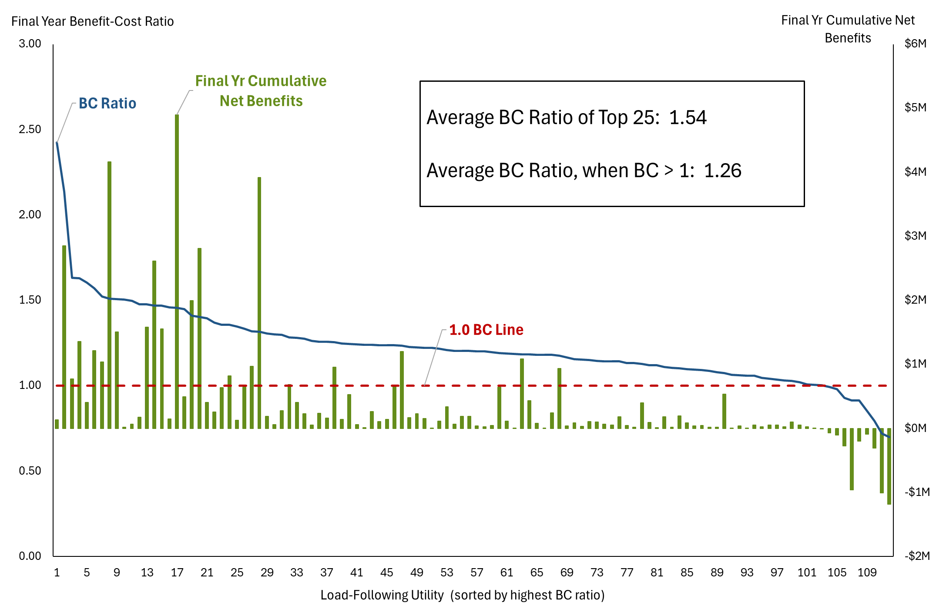
New Tools to Find Value
Most utilities see significant financial benefit from Daily DVR
Tools to define each utility’s specific value (generally large).
Tools are easy to use and customizable.
92% of utilities would benefit financially.
Average yearly rate of return is 20% (in a conservative scenario).
Scenario Note: BPA FY26 rate structure held flat post-2028

Slide 19
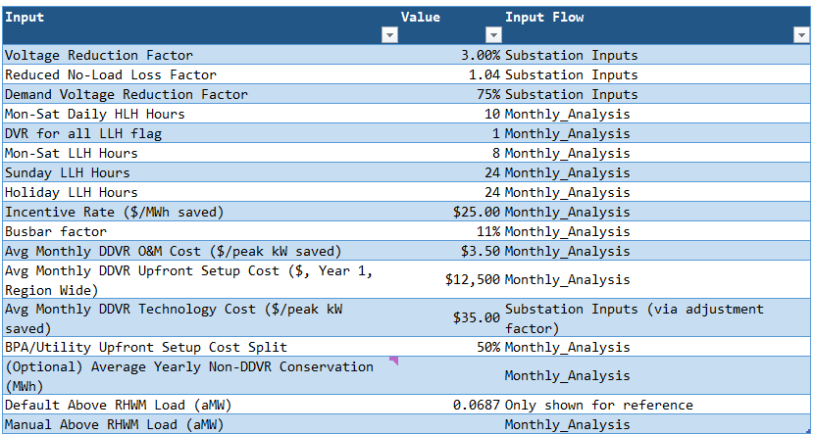
Easy to Use Tools (1 of 4)
The tools are easy to use, have great defaults, and customizable
Excel screenshot of required inputs and pre-filled defaults
Extensive documentation listing assumptions and sources.
Pre-loaded with great defaults.
Extremely customizable.
No macros!

Slide 20
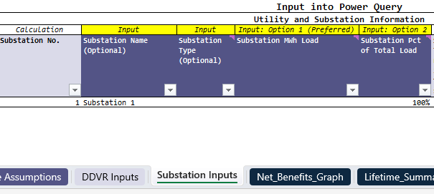
Easy to Use Tools (2 of 4)
Calculates benefits and costs at the substation level
Excel screenshot of required and optional substation inputs
Input substation loads.
Adjust other inputs as desired, such as:
  1. Voltage reduction
  2. Residential and commercial load shares
  3. Heating and cooling saturations

Slide 21
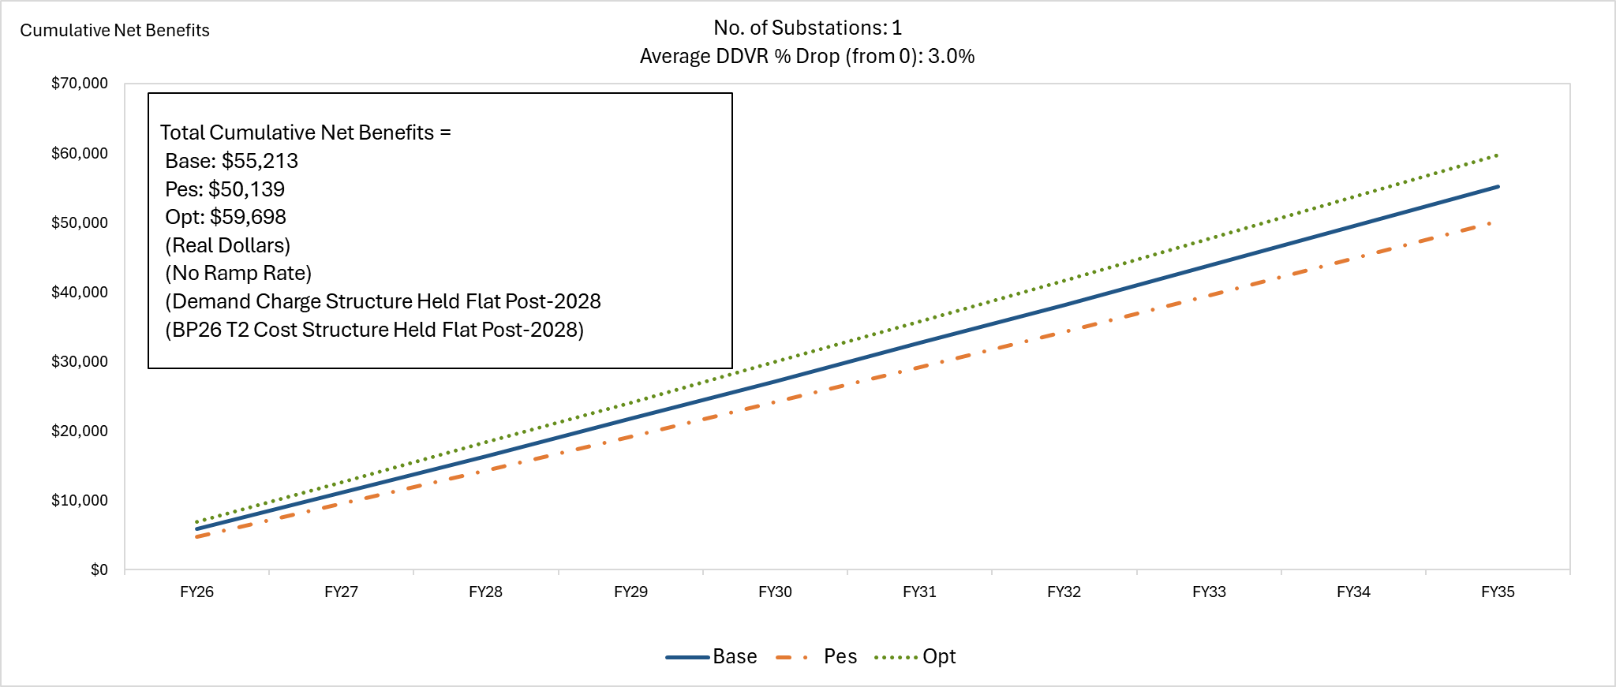
Easy to Use Tools (3 of 4)
Outputs a range of lifetime net benefits—BP26 rate structure held flat
Real screenshot from a real utility’s real substation

Slide 22
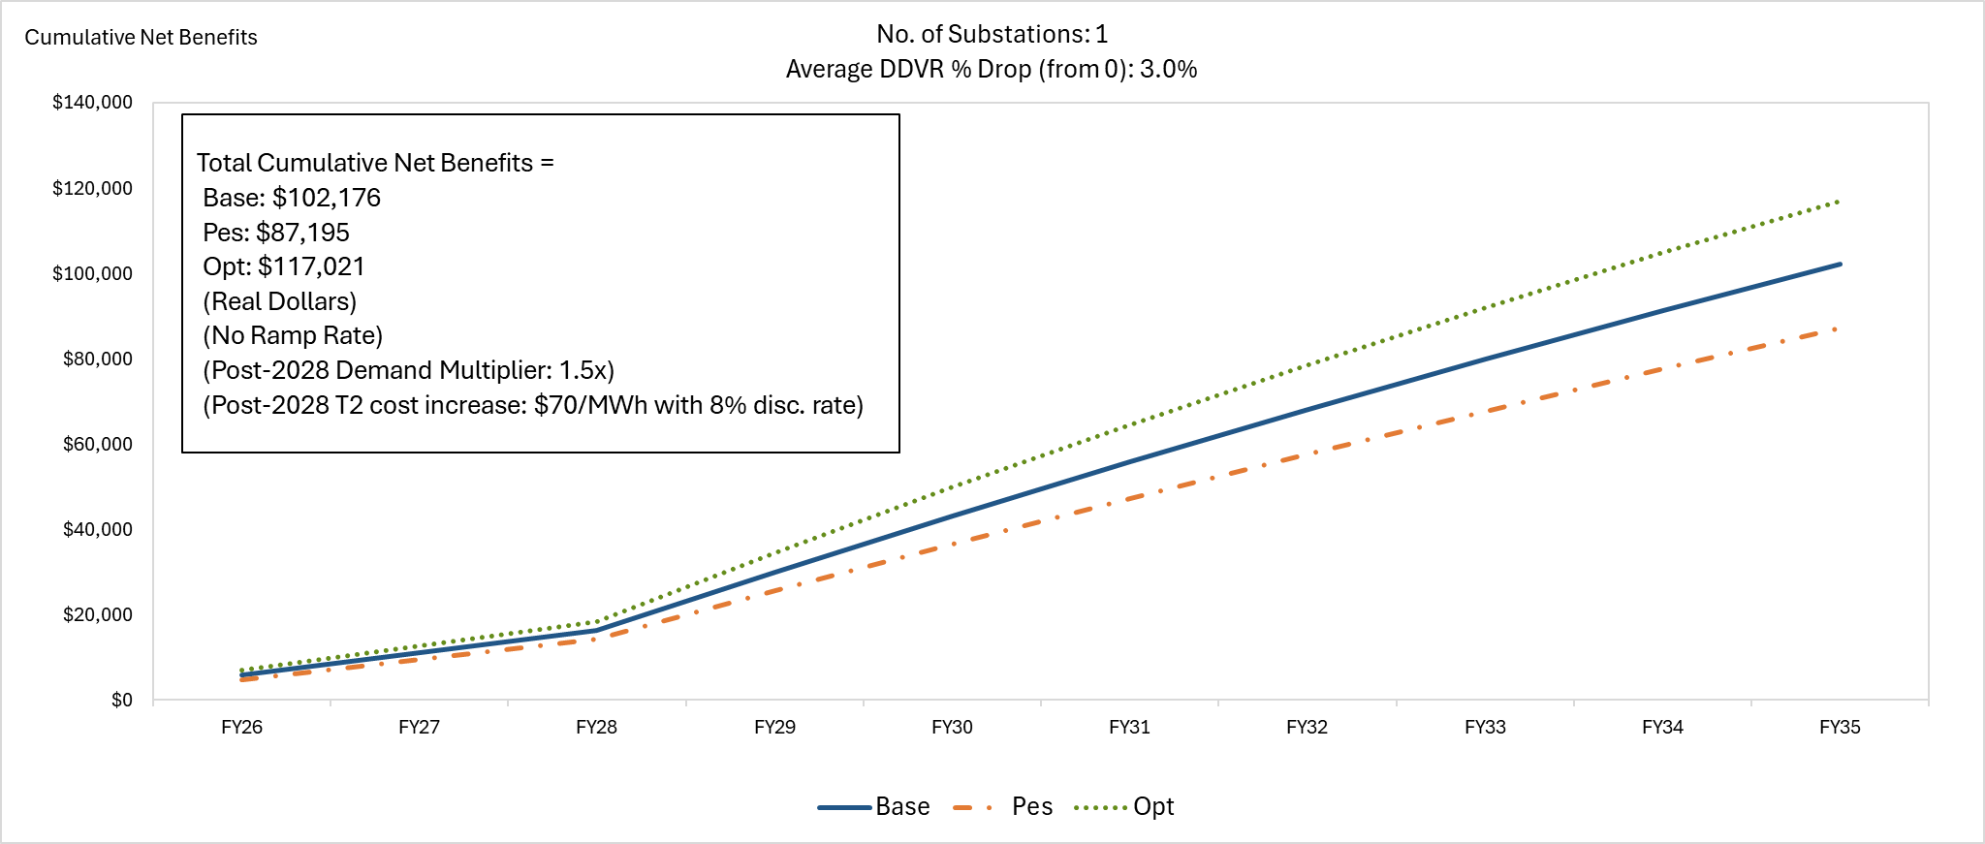
Easy to Use Tools (4 of 4)
Outputs a range of lifetime net benefits—post-2028 rate increase
Real screenshot from a real utility’s real substation

Slide 23
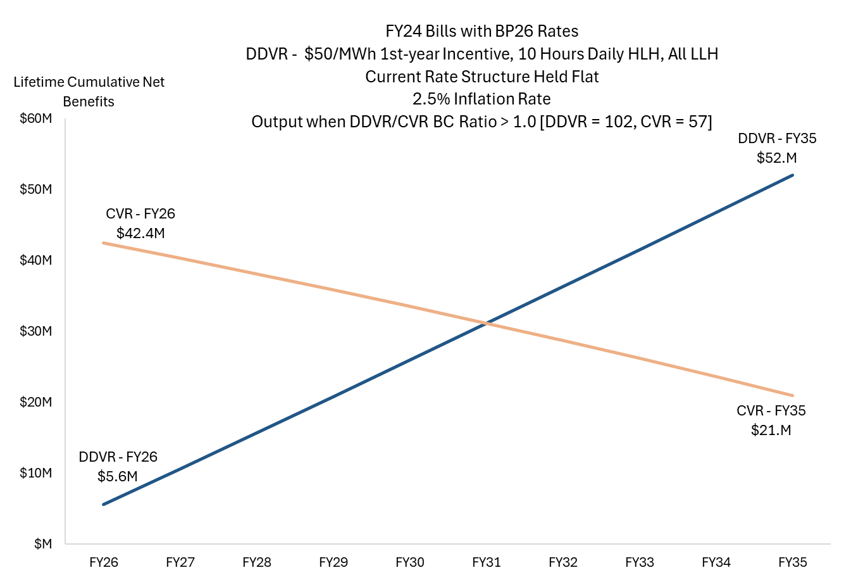
CVR and Daily DVR Work Well Together
BPA has three tools for utilities
Utilities have product choice
Daily DVR, CVR, or Hybrid
Easier to start with modest CVR and get a large incentive
Target Daily DVR upgrades over time
Scenario Note: BPA FY26 rate structure held flat post-2028
Notes:
CVR benefits are high in the early years due to a large incentive check
Lost revenue drives down CVR net benefits in later years
DDVR costs are high in early years, if distribution costs are needed
Some utilities have already made sufficient upgrades, meaning that DDVR pays off immediately
Using a combination is likely the best approach for most if not all utilities

Slide 24
Bill Savings Drive Value
Most of Daily DVR’s benefits come from bill savings
About 77% of the benefits come from bill savings.
About 23% of the benefits come from a yearly incentive.
BPA can provide support to help utilities understand Daily DVR’s value.
Net benefits are positive because Daily DVR minimizes lost revenue.
Benefit Component | % of Benefits
Energy Charge | 37%
Demand Charge | 30%
Transmission Charge | 10%
Energy Efficiency Incentive | 23%
Total Yearly Benefits (FY24 Load Following Utilities) | ~$24M

Slide 25
Increased Support
BPA is doubling the incentive in the first year
Increased first-year incentive to $0.05/kWh
Better defined system requirements for clearer implementation
Technical guidance for customers:
  Talking with distribution engineers or SCADA vendors
  Support for setting up databases and transferring data
  Using the tools and understanding scenarios
Cost share potential (based on need and resources)

Slide 26
Implementation Recommendation
BPA’s tools can help you make decisions to optimize your benefits
Implementation Component | Daily DVR | CVR
Voltage reduction | Moderate (3-5%) | Minimal (1-2%)
Per event run-time | At least 5 hours | n/a, all year
Months available | 12 (Target high prices) | Must run all year
Daily Run Schedule | - 5 hours morning peak - 5 hours evening peak - All evening hours, Sundays, and holidays | All hours

Slide 27
Why You Should Care
A new opportunity and a changing environment

Slide 28
Unique Value, Targeted Opportunity
Low-cost measure in a time of declining opportunity
Significant regional potential
Targeted to address utility specific needs
Value for the utility, value for all members/customers
Growing value in 2029 for Tier 2 customers

Slide 29
Next Steps
Contact your EER to understand the potential value for your utility and get your tools.
Work with BPA technical staff on data and infrastructure needs.
Pilot implementation for a short time on a small scale.
Scale up to target your specific needs.

Slide 30
Questions
What do you want to know?

