Slide 1
Future State and Our Customers

Slide 2
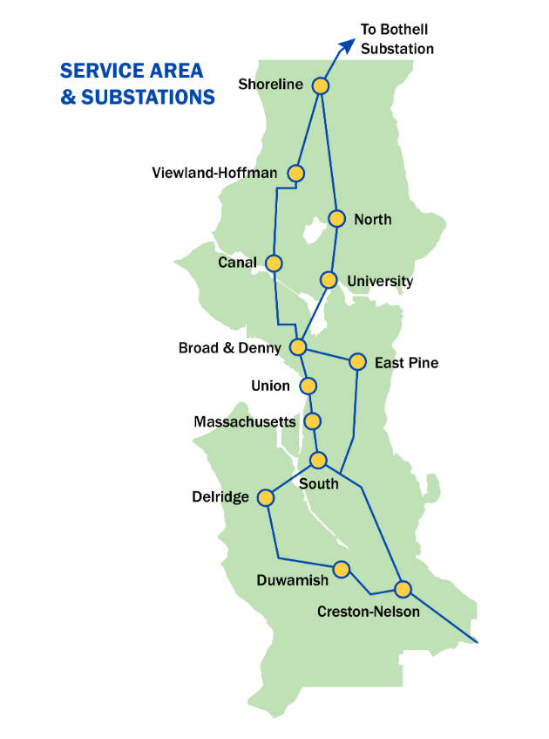
Seattle City Light
~500,000 metered customers
~660 miles of transmission lines
~2000MW of winter peak load
~1100MW SCL resources dependent on BPA Transmission
Nearly all market purchases dependent on BPA Transmission
We cannot serve our load today or in the future without BPA Transmission

Slide 3
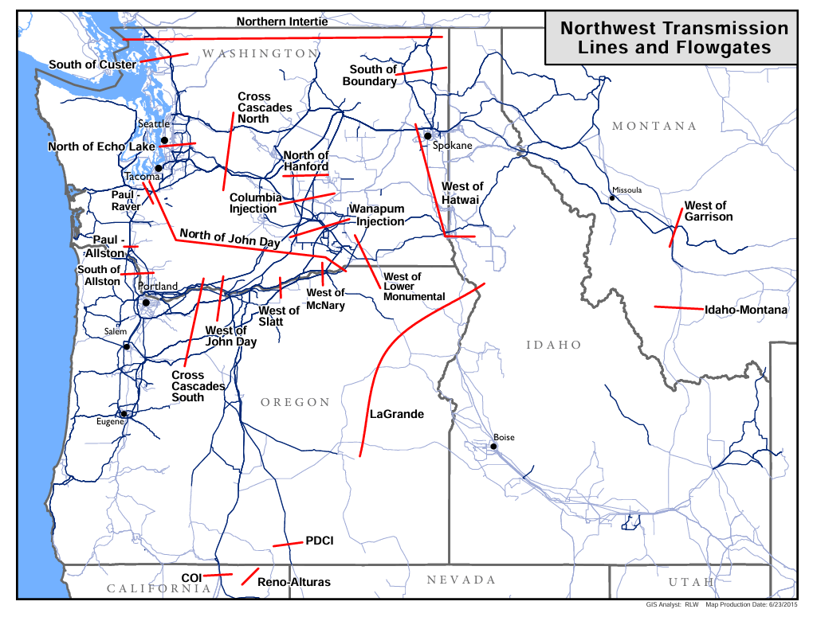
Regional Needs
Residential Load Growth
Electrification Load Growth
Industrial Load Growth
Data Center Load Growth
Carbon free resources growth
Coal/Gas Retirements
Unconstrained Markets

Slide 4

Recommended Future State
Proactive Tx Planning
  BPA uses a probabilistic study approach to build ahead of Customer Need.
Fast Execution
  Projects energized in 5 to 6 years from inception.
Interim CFS service
  Offered in a short amount of time

Slide 5

Why plan for this Future State?
Customer load growth will be served reliably
Faster access to interconnection
Less Scarcity = Lower Prices
Lower Prices = Lower Rates

Slide 6
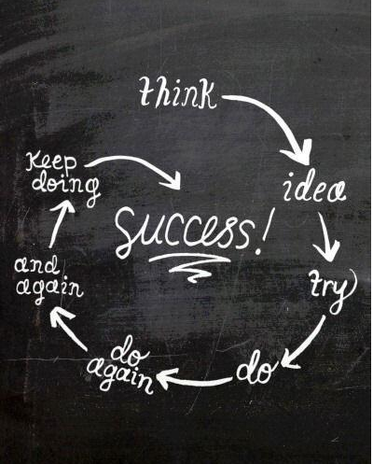
We need to support BPA getting to the Future State
We believe the Future State is the lowest cost route for the region and our customers
The Future State ensures maintaining our superior level of grid reliability
We recognize policy changes have adverse impacts
We believe the benefits of this change far outweigh impacts, costs, and risks of not changing.

Slide 7

BPA’s proposal does not solve the stated problem
Stated Problem: The Queue is too large for an actionable commercial transmission study.
BPA proposal framework will only reduce the Queue to ~31GW at best
31GW would likely take 5-7 years to study
Customers can’t wait 5-7 years
Same framework, No transformative change

Slide 8
Customer Perception: BPA is stuck at “I Can’t Do It”

Slide 9

Recommended Solution to Consider
Start Proactive Planning NOW
Accelerate Expansion through BPA Reform
Offer interim CFS with few exceptions
Minor, low risk changes to Readiness Criteria
LTF Queue management - Customer Choice
Fastest way to offer service.

Slide 10
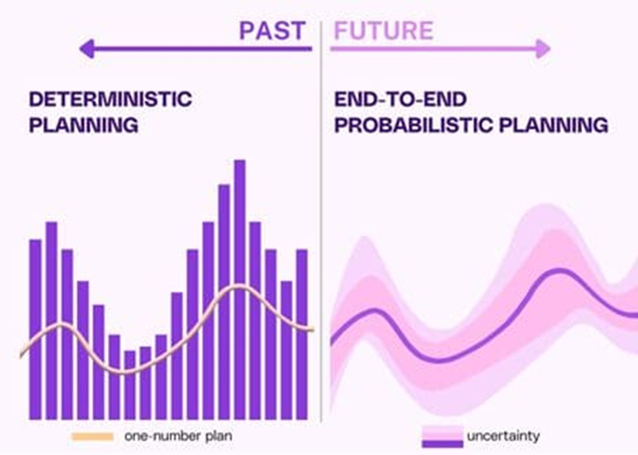
Start Proactive Planning NOW
We need to plan for the future now
Strategic, focus on the future.
No commercial study for transition period.
PTDFs used for assigning capacity. (Just, Fair, & Reasonable)
Facilitates fast interconnection

Slide 11

Accelerate Expansion through BPA Reform
BPA’s proposal only changes BPA contracting process.
We suggest BPA consider exploring internal organizational process and structure changes that support accelerating transmission expansion.

Slide 12

Offer Interim CFS with few exceptions for risk
Exception for few sub-grid constraints
Maintains Reliability through curtailment during extreme weather events
Interim Service Contract Mandatory
Leads to long-term firm service
Contractual obligation to securitize 5 years of service charges
Allows resources to focus on proactive planning

Slide 13
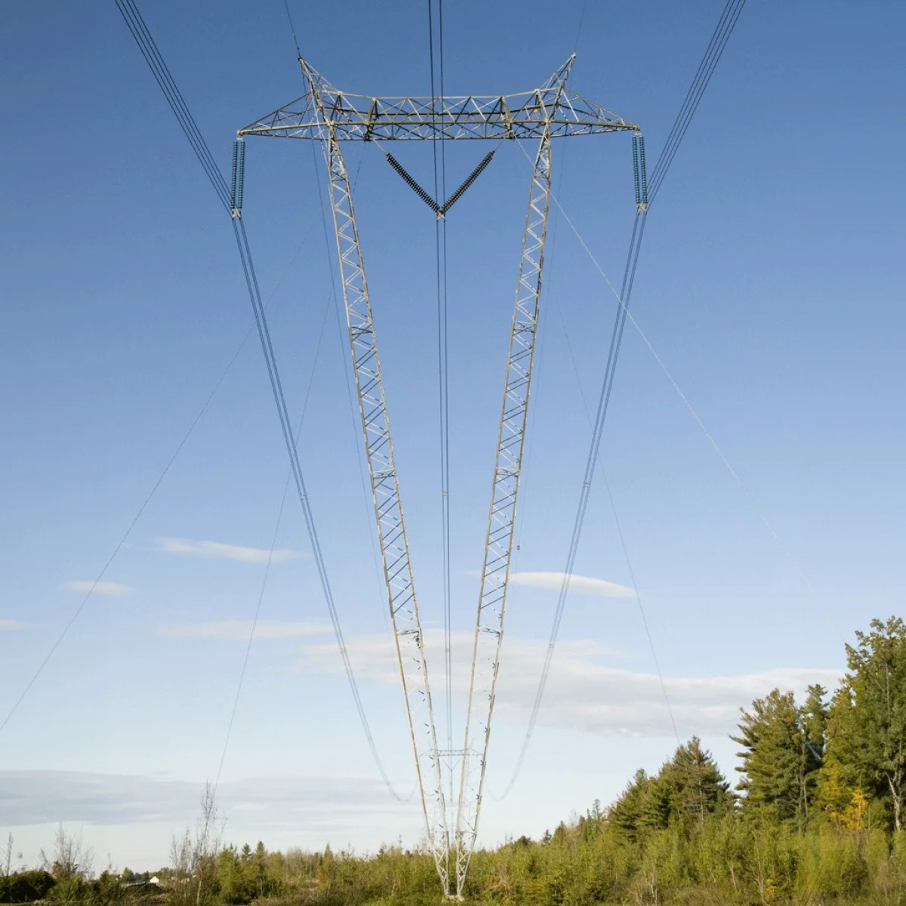
Interim CFS path to firm Long-Term Service
After Proactive Planning Established, 3-5 years
Full commercial study; Plan of Service offer to remaining queue by three time periods
  TSRs Prior to 8/15/2024
  TSRs 8/15/2024 to 10/01/2025
  TSRs After 10/01/2025
Limited Deferral

Slide 14

Minor Changes to Readiness Criteria
Criteria addressing challenges with hubs will still be needed
No further criteria needed when providing incentives for customers to make rational decisions when offered interim non-firm service
Eliminates risk of lengthy legal challenges to new criteria
Maintains Open Access

Slide 15
LTF Queue management - Customer Choice
Queue position for offering long term firm service respected.
Mandatory Interim service followed by a choice to take Plan of Service offer
Limited deferral of start date.
No Harm, future state coming.

Slide 16
BPA Proposal Alternative changes under this framework
Source Maturity (EC-SM) – not needed or EC-SM-ALT-5
RAS Resource (EC-RAS) - EC-RAS-ALT-4, Arming load is not a solution.
PTP requests to NT PODs (EC-PTP) – Likely not needed
Delivering/Receiving Party Validation (EC-PV) – not needed
Product Options (IS-POPT) – Use standard CFS product
Mandatory-Voluntary (IS-MV) – IS-MV-ALT-2 Mandatory at service offer.
Curtailment Type (IS-CT) – System Conditions only, no study needed

Slide 17
BPA Proposal Alternative Changes Continued
Applying Evaluation Criteria to the Queue (QM-ECQ) – Limited by agreement, avoids risk
Structuring the Queue for Study (QM-SQS) – Three Time Periods, queue order
  TSRs Prior to 8/15/2024 - 1st group Offered interim CFS in Transition, 1st group for full commercial study in future state.
  TSRs 8/15/2024 to 10/01/2025 - 2nd group offered interim CFS in Transition, 2nd group for full commercial study in future state
  TSRs after 10/01/2025 - 3rd group offered interim CFS in Transition, 3rd group for full commercial study in future state.

Slide 18
BPA Proposal Alternative Changes Continued
Firm Service Prioritization (QM-FSP) - Queue order
Transition Studies (PP-TS) - Focus on Proactive Planning and offering CFS. No full commercial studies.

